Slide 1
Test Plan

Slide 2
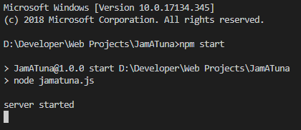
Run Server
Run the following commands in the project directory
npm install
npm start

Slide 3
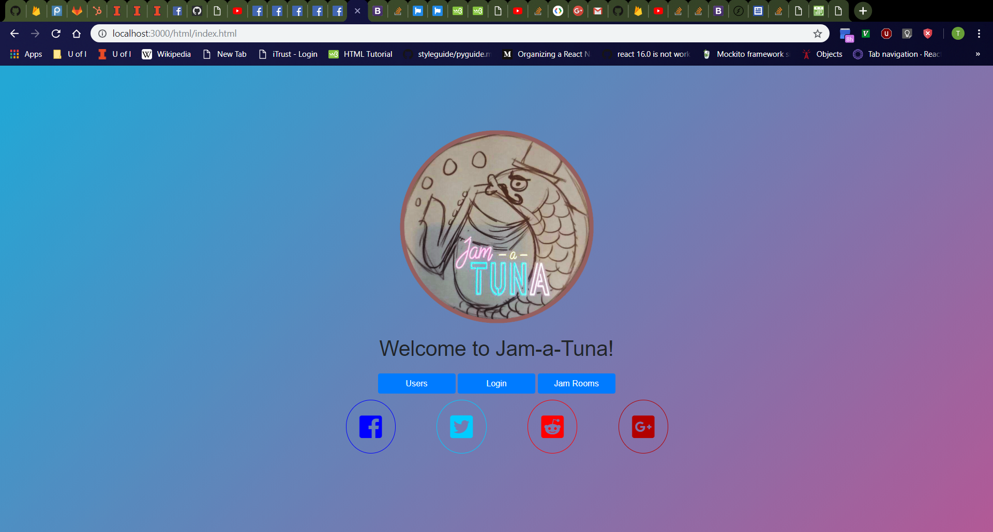
Home Page
Navigate to http://localhost:3000/
Should see Jam-a-Tuna image, text, and buttons
Should see animated gradient background that transitions from cyan-blue in top-left corner to purplish-red in bottom-right corner on nearly every webpage
Should see Facebook, Twitter, Reddit, and Google+ icons that work by sharing the website to social media
“Users”, “Login” and “Jam Rooms” buttons should take you to a new page
Page should be centered in middle of browser
Should NOT see “Profile” and “Logout” buttons upon first visit to website in tab because no login has happened yet

Slide 4
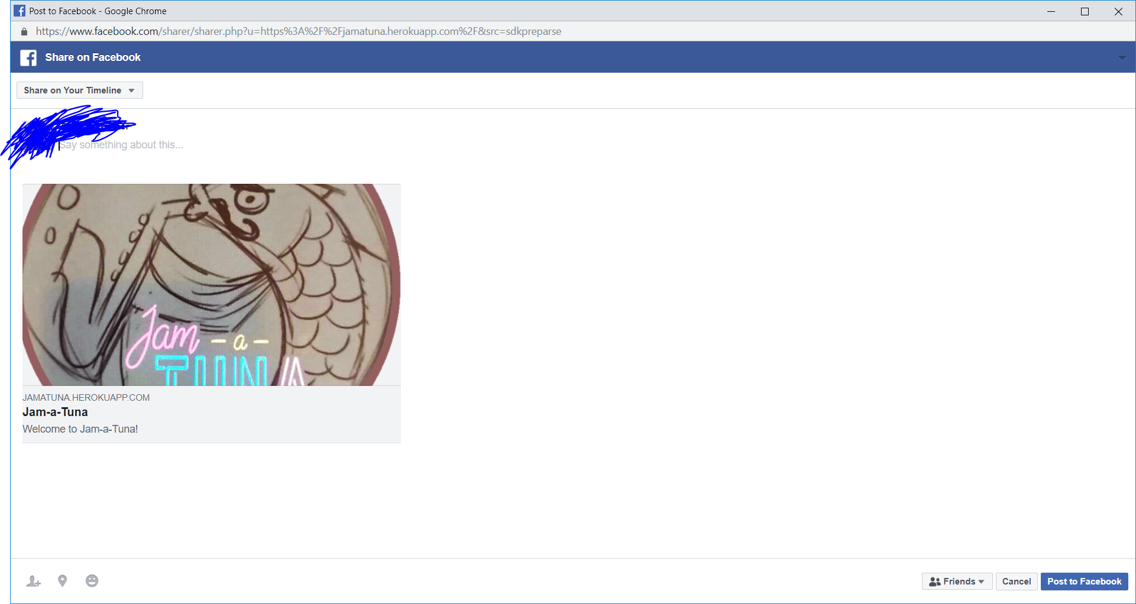
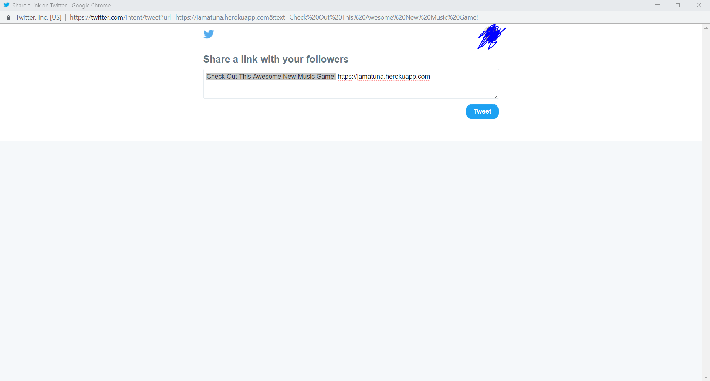
Social Media
Click Facebook button
Should see Facebook share dialog with JamATuna logo as thumbnail, “Jam-a-Tuna” as the title, and “Welcome to Jam-a-Tuna!” as the description
Click Twitter button
Should see Twitter share dialog with text box filled with text “Check Out This Awesome New Music Game! https://jamatuna.herokuapp.com”
Facebook Share Dialog
Twitter Share Dialog

Slide 5
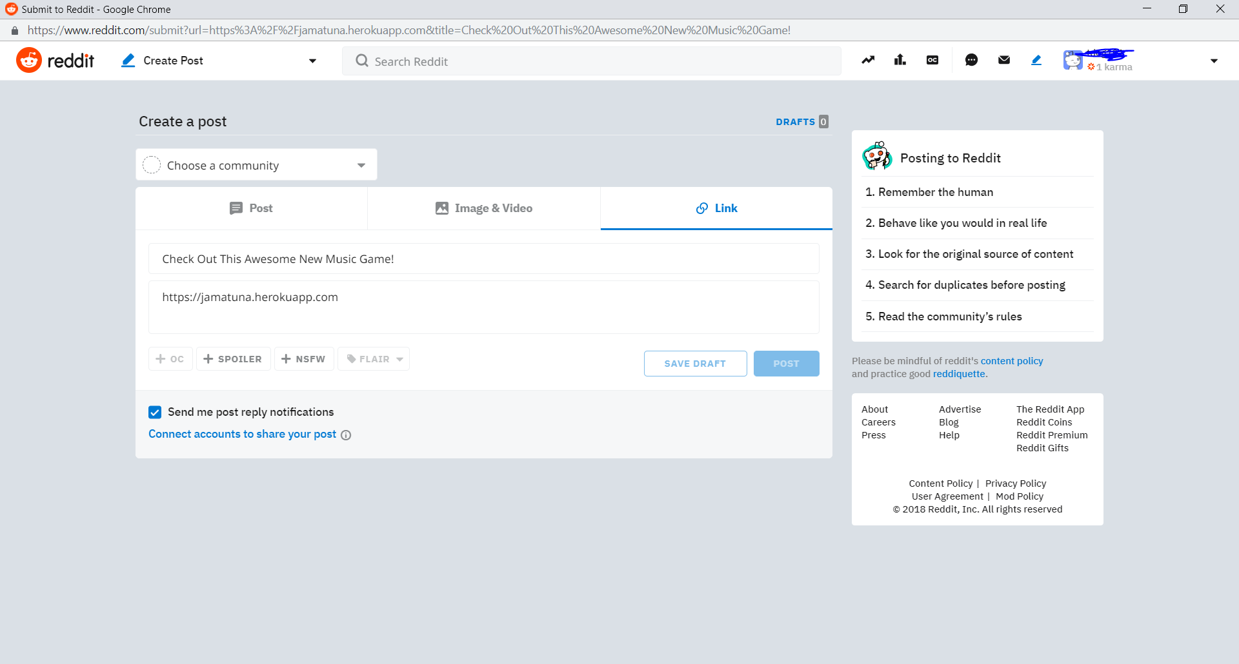
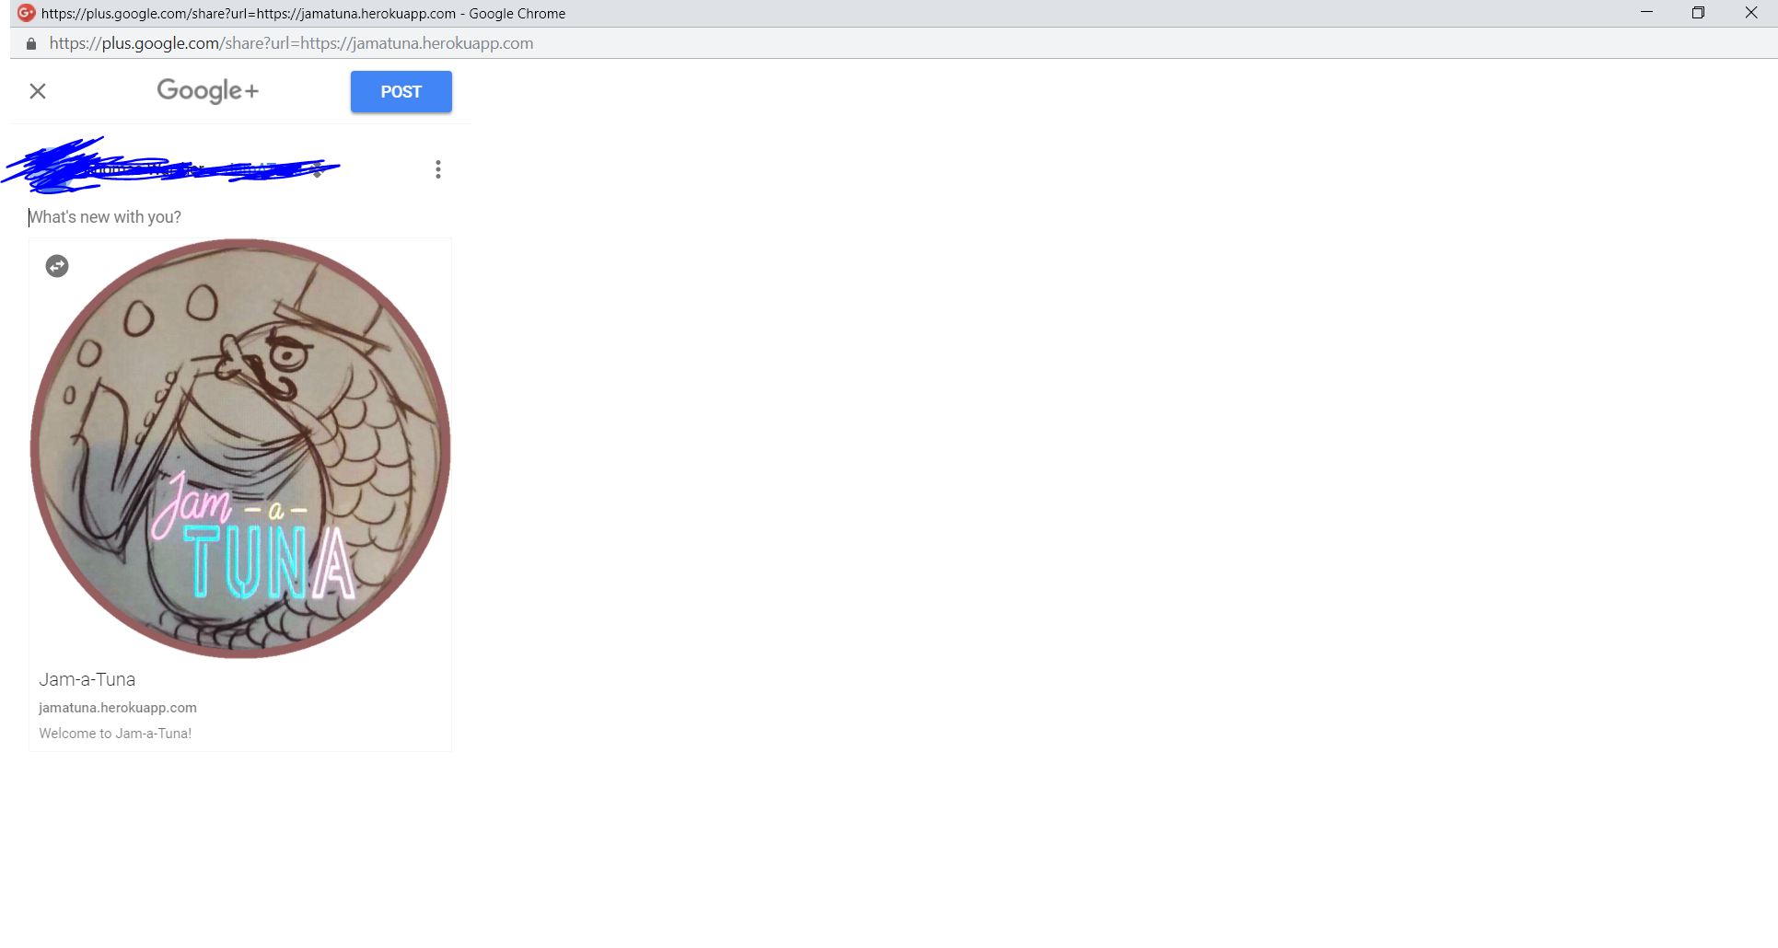
Social Media Cont.
Click Reddit button
Should see Reddit link dialog with title “Check Out This Awesome New Music Game!” and body “https://jamatuna.herokuapp.com”
Click Google+ button
Should see Google+ share dialog with JamATuna logo as thumbnail, “Jam-a-Tuna” as the title, and “Welcome to Jam-a-Tuna!” as the description
Reddit Link Dialog
Google+ Share Dialog

Slide 6
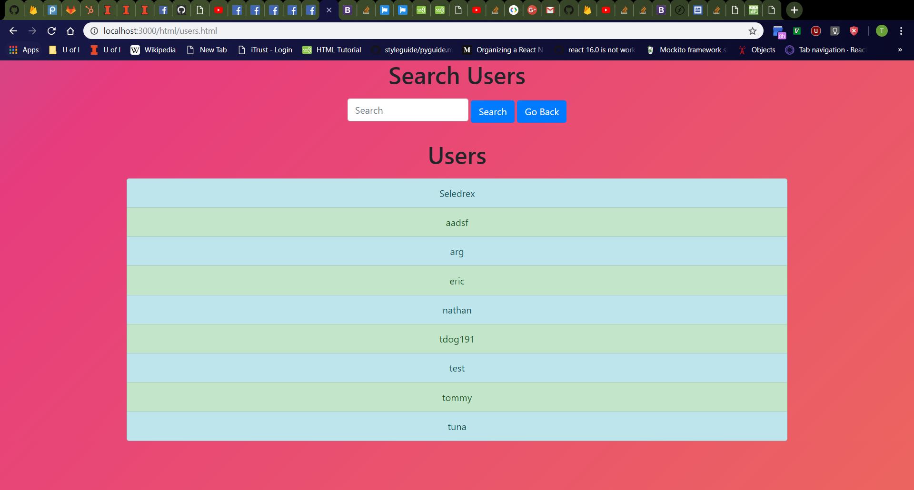
Users Page
Click “Users” button on home page.
Should navigate to http://localhost:3000/html/users.html
From top to bottom; should see “Search Users” header; a row containing a search bar, a “Search” button, and a “Go Back” button from left to right; a “Users” header; and a list of all usernames in the database
Search bar should be empty with “Search” placeholder.
Odd-numbered list entries should be colored light-blue while even-numbered entries are colored light-green.

Slide 7
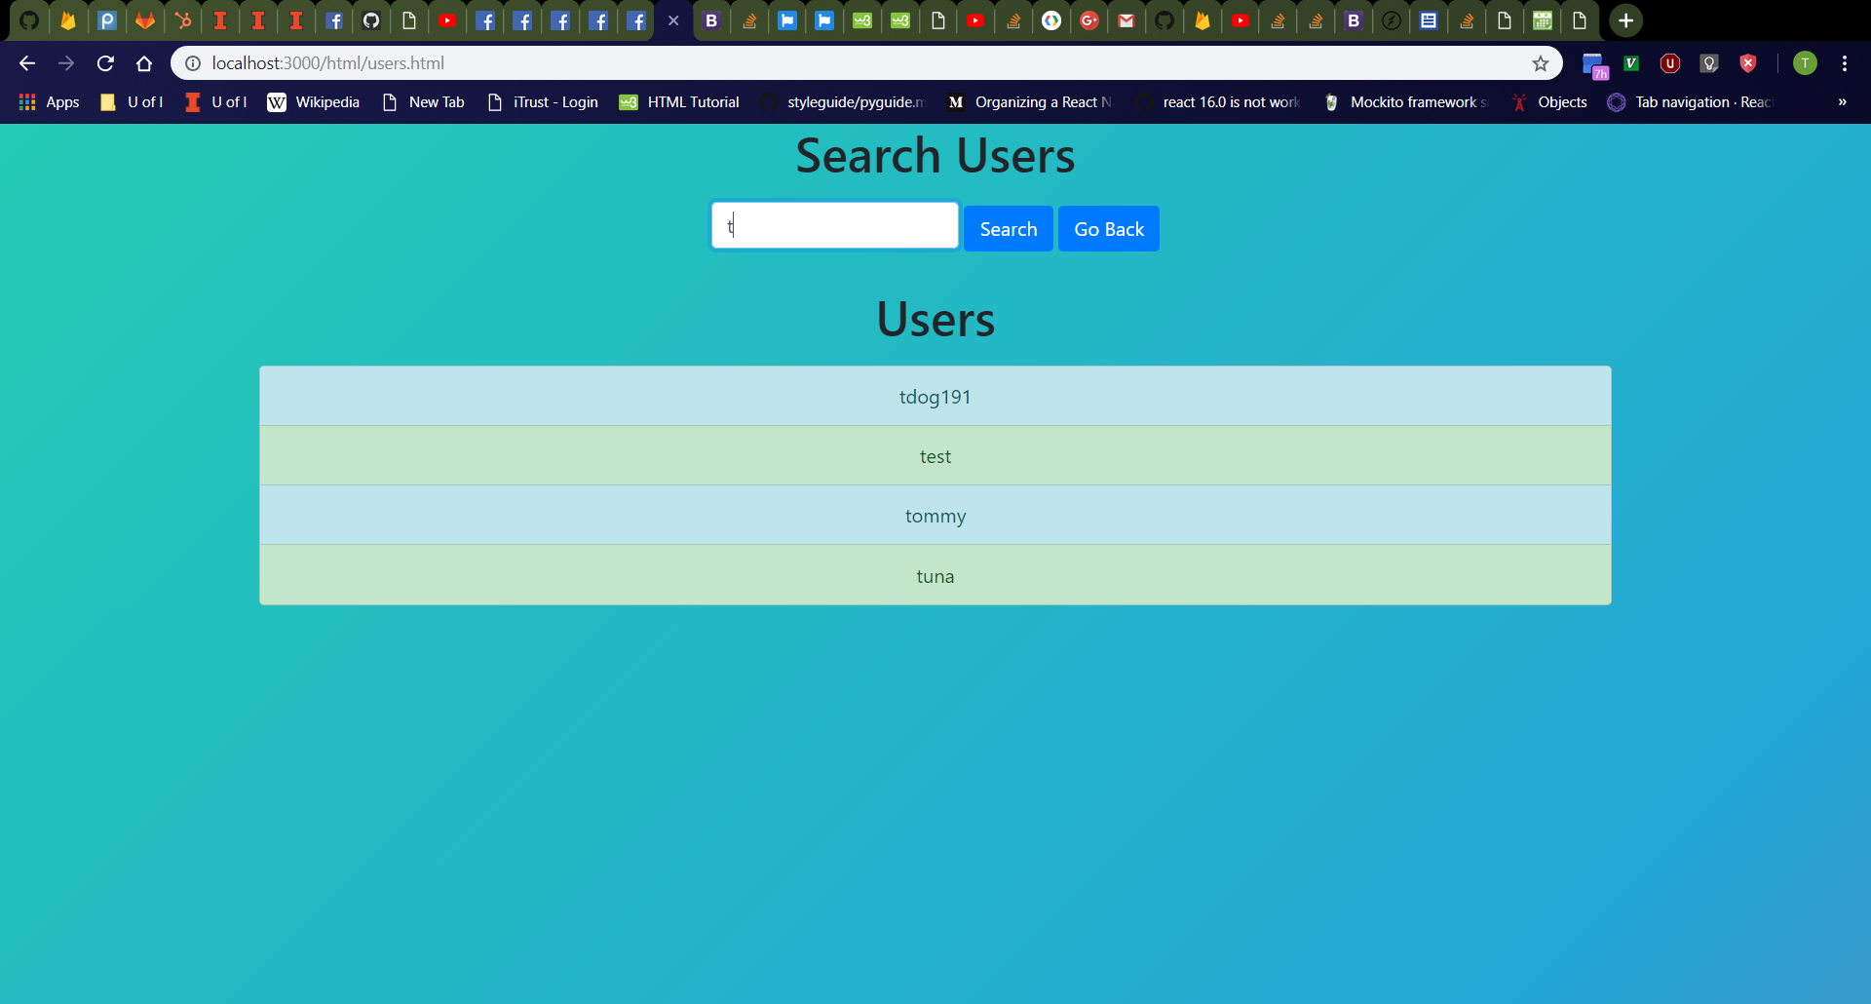

User Search
First Search
Enter “t” (or other prefix (ignoring case) of a username in the list) into search bar and click “Search” button.
User list should only display usernames in database with matching prefixes (ignoring case)
Odd-numbered entries should still be colored light-blue while even-numbered entries should still be colored light-green.
Enter “tdog191” (or other username in database) into search bar and click “Search” button.
Old search results should disappear, and the new search results should be displayed.
Second Search

Slide 8
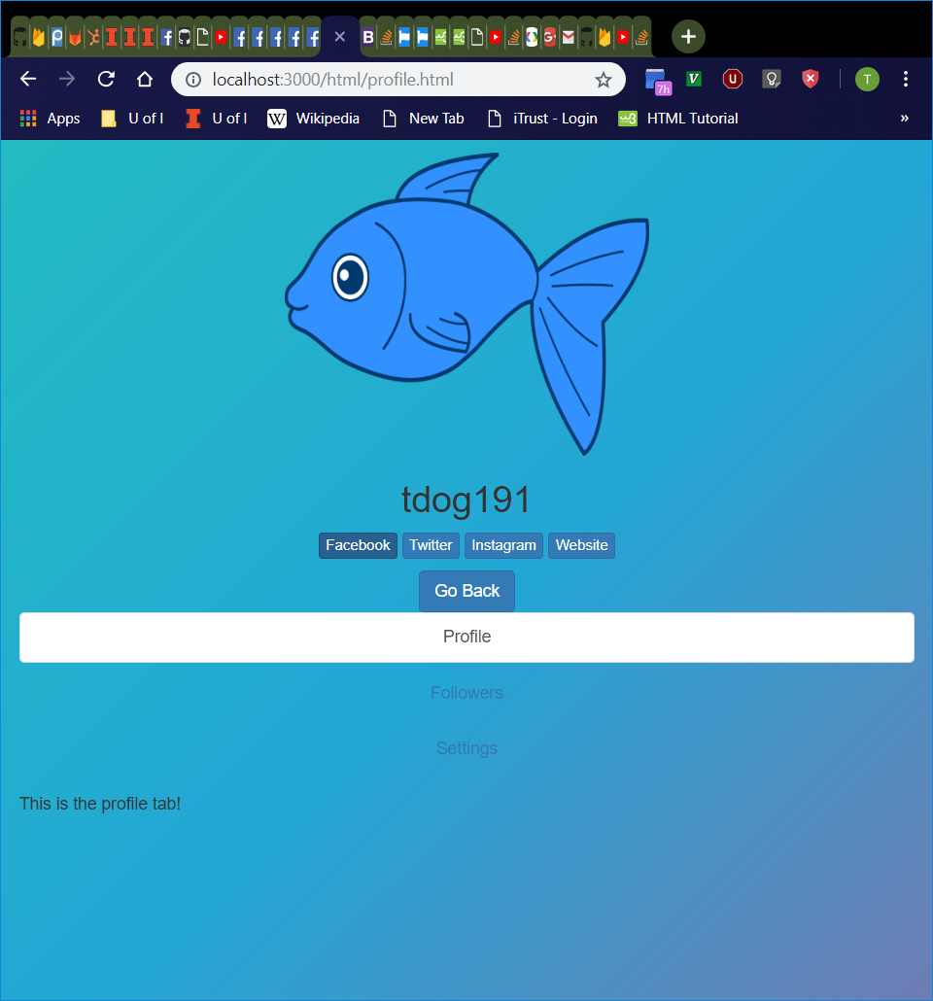
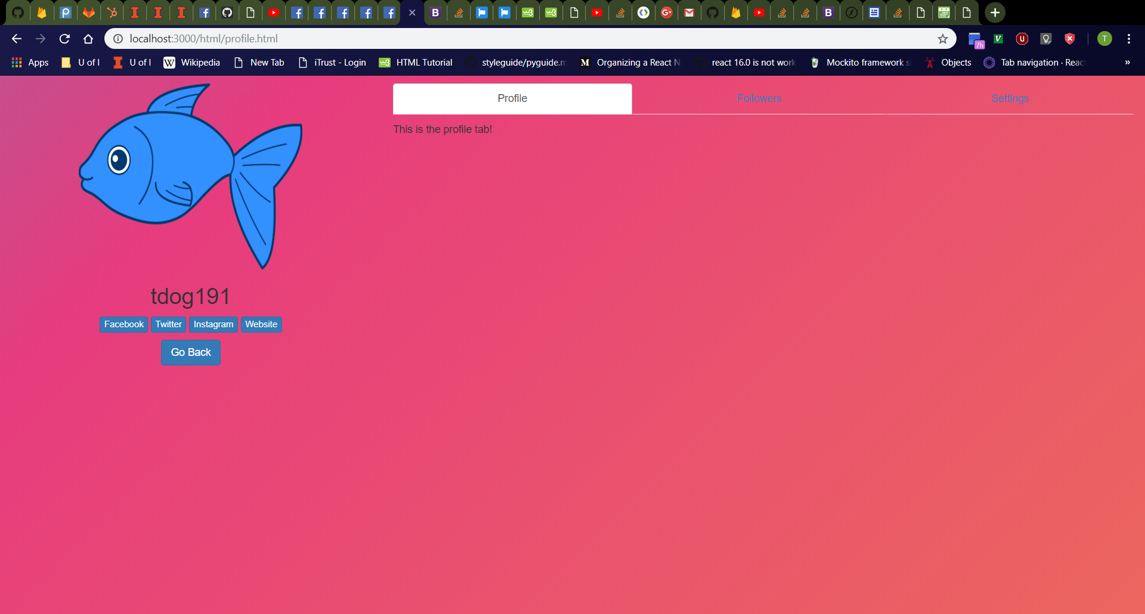
Profile Page
Vertical Window
Click “tdog191” (or other search result entry on “Users” page).
Should navigate to http://localhost:3000/html/profile.html
Should see profile page with “Profile”, “Followers”, and “Settings” tabs
Should see user’s profile picture with user’s username, social media buttons (not implemented), and “Go Back” button underneath
Tabs should be clickable.
Profile page should adjust layout depending on screen orientation.
Full-Sized Window

Slide 9
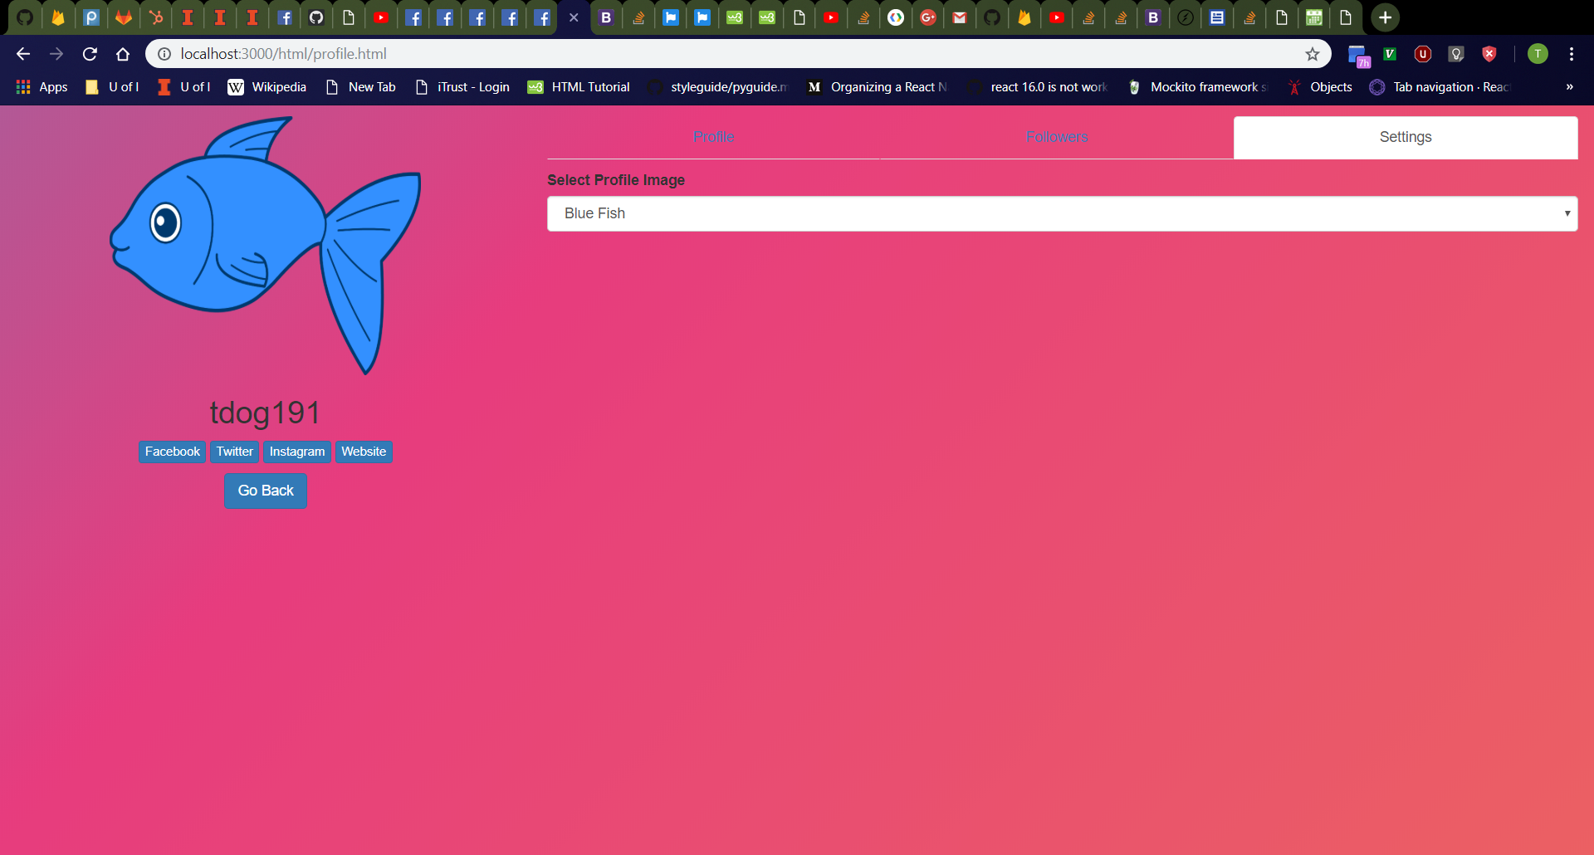
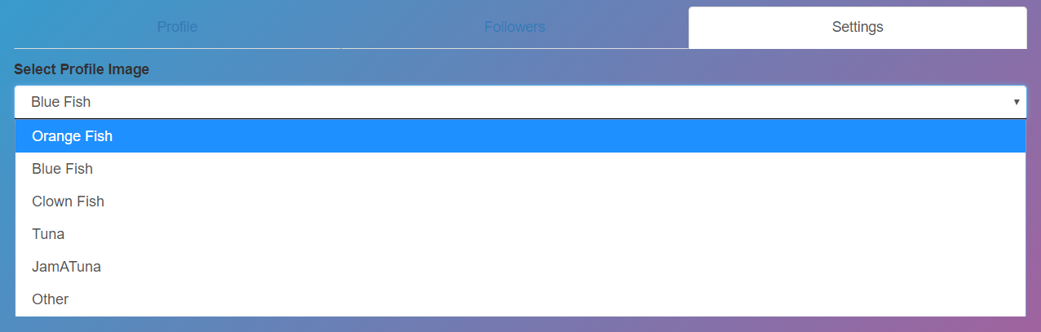
Settings Tab
Settings Tab
Click “Settings” tab on “Profile” page.
Should see dropdown menu with label “Select Profile Image”
Dropdown menu should have image corresponding to profile picture selected by default (“Blue Fish” in examples on this slide).
Dropdown menu should have “Orange Fish”, “Blue Fish”, “Clown Fish”, “Tuna”, “JamATuna”, and “Other” options.
Dropdown Menu

Slide 10
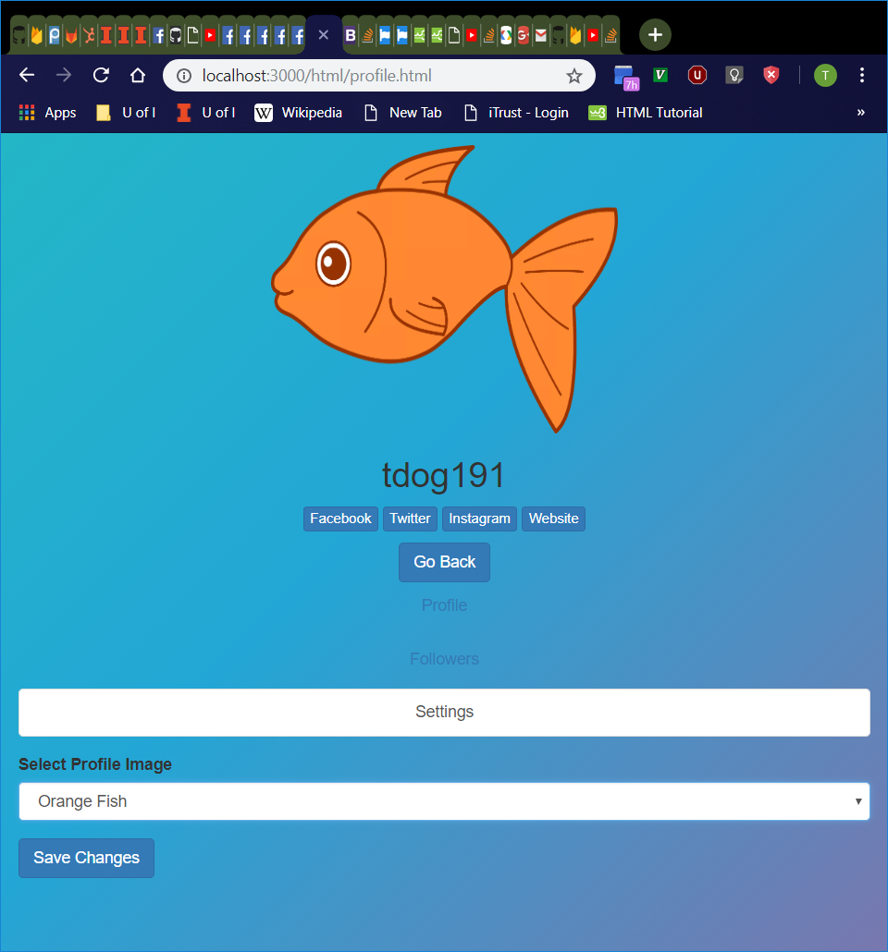
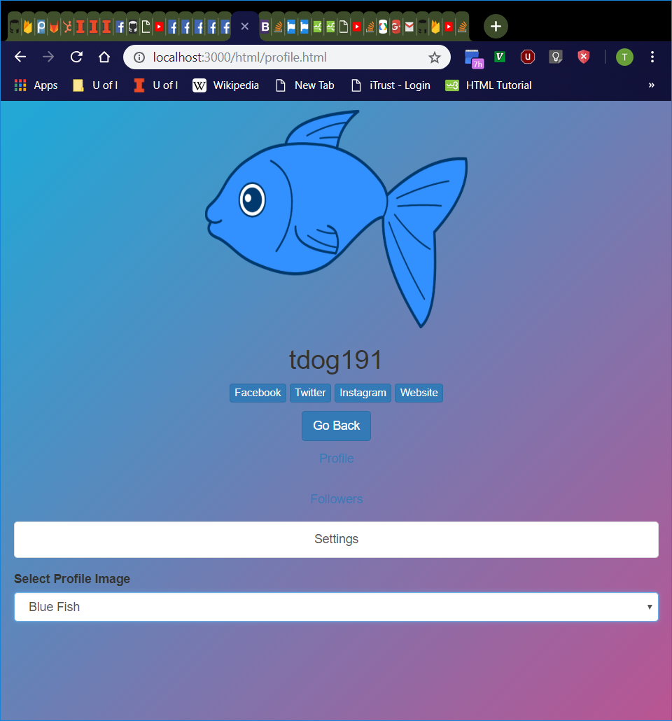
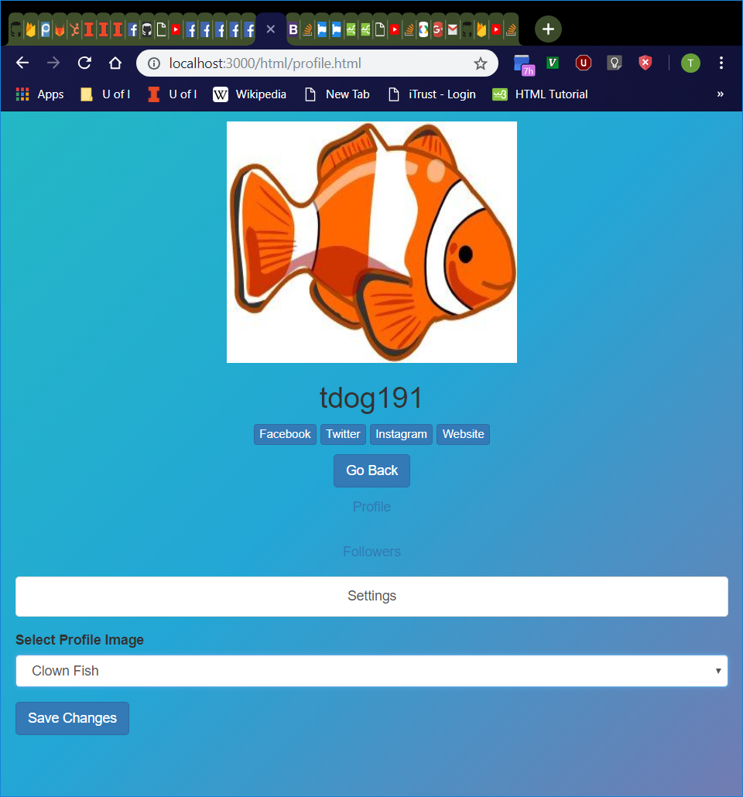
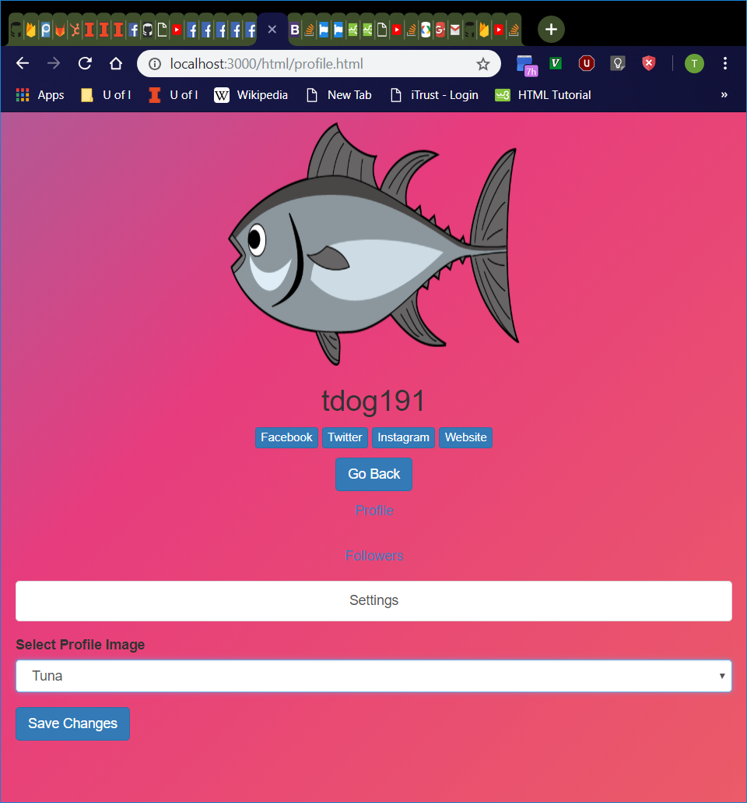
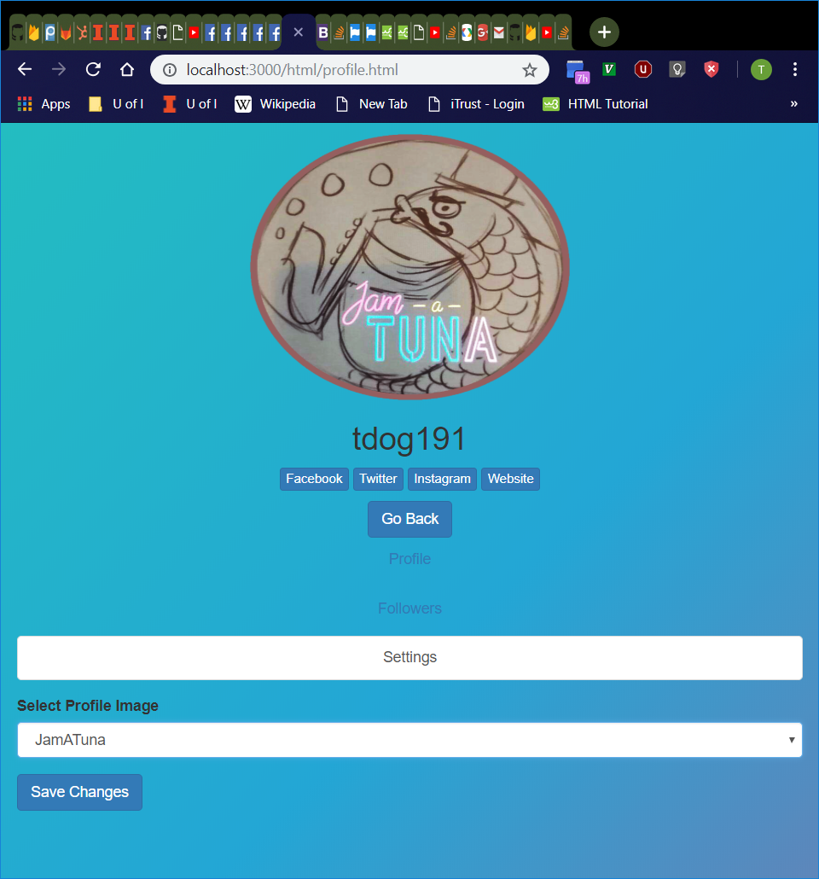
Available Profile Pictures
Select every option in the “Settings” tab dropdown menu, one-by-one except “Other”.
Profile picture should be updated with the appropriate picture.
If selected option is different from the picture that initially displayed upon loading the profile page, a “Save Changes” button should appear.
If selecting the initial picture after selecting a different picture, the “Save Changes” button should disappear.
Orange Fish
Blue Fish
Clown Fish
Tuna
JamATuna

Slide 11
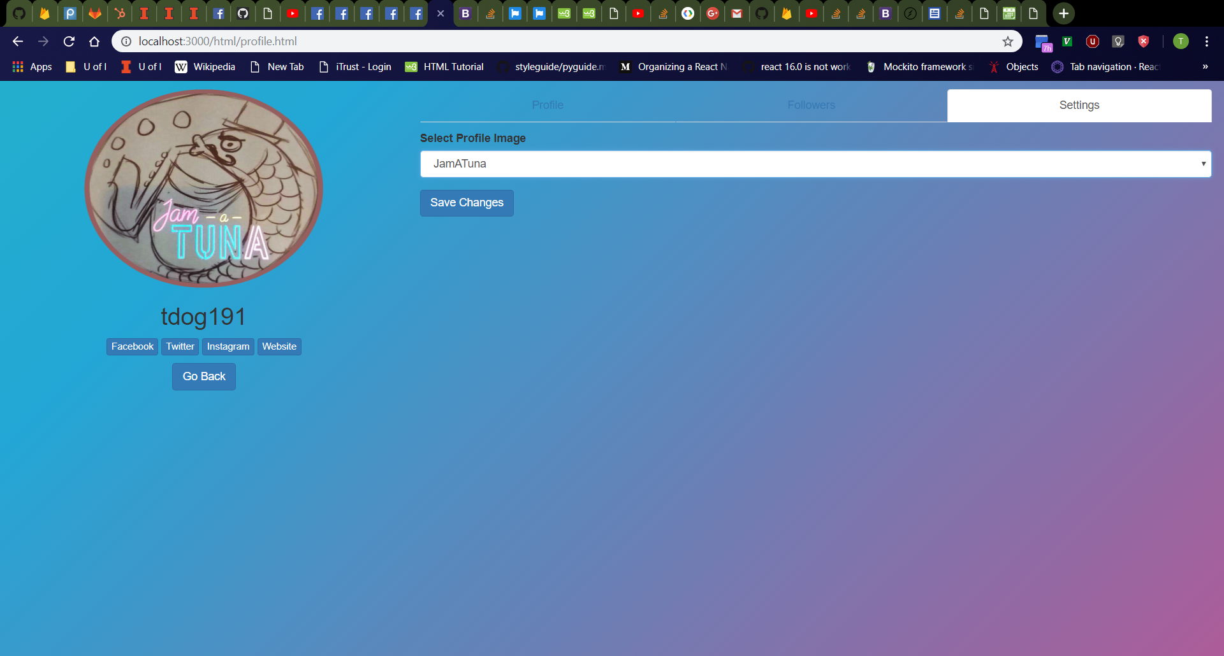
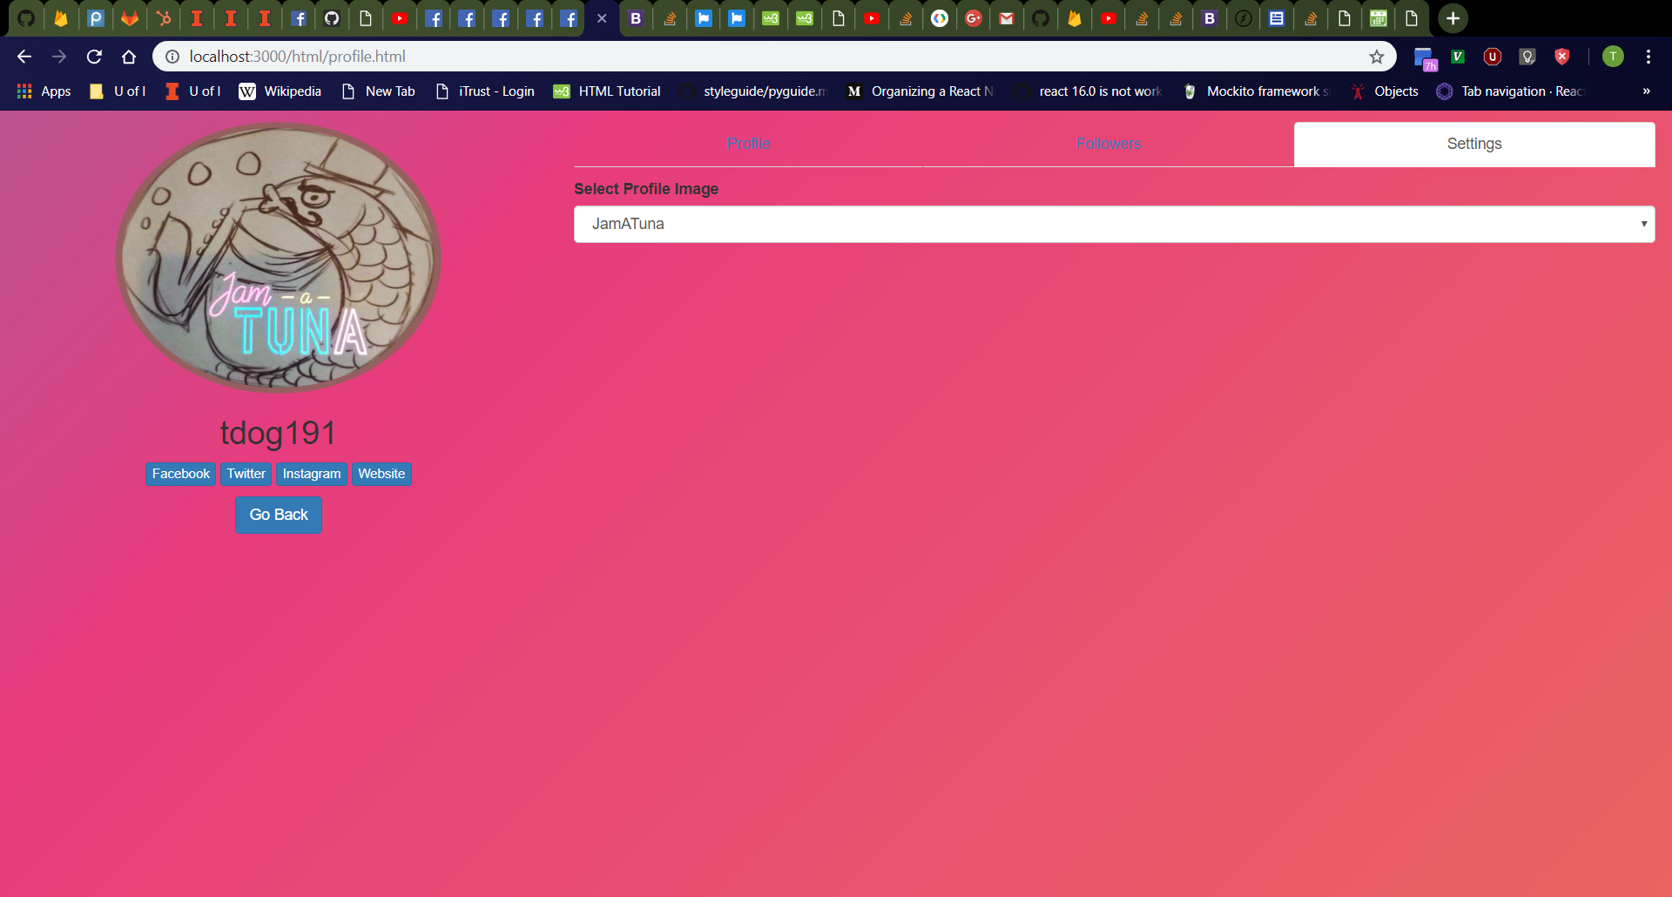
“Save Changes” Button
Before Clicking Button
Select “JamATuna” (or other option different from profile picture initially loaded onto page) then click “Save Changes” button.
Page should refresh with selected picture.
The “Select Profile Image” bar in the “Settings” tab should default to the selected image.
The “Save Changes” button should disappear.
After Clicking Button

Slide 12
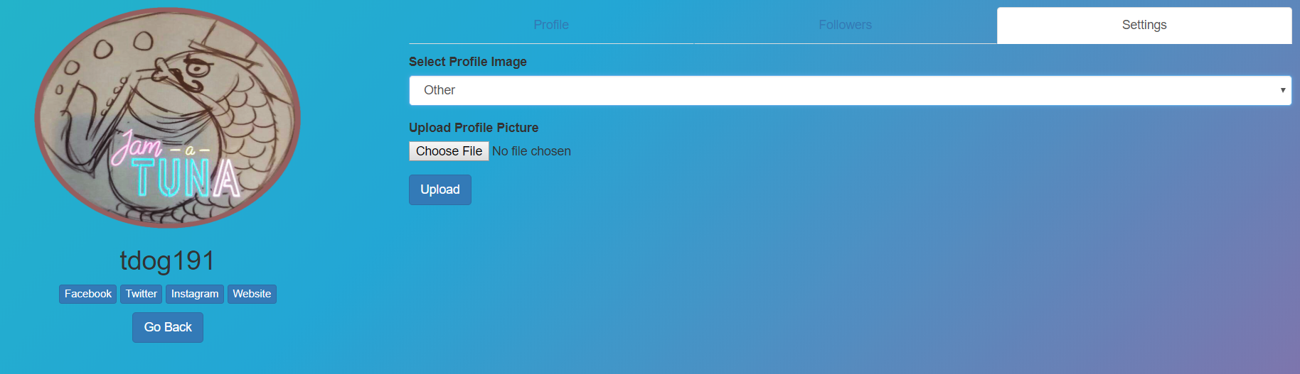
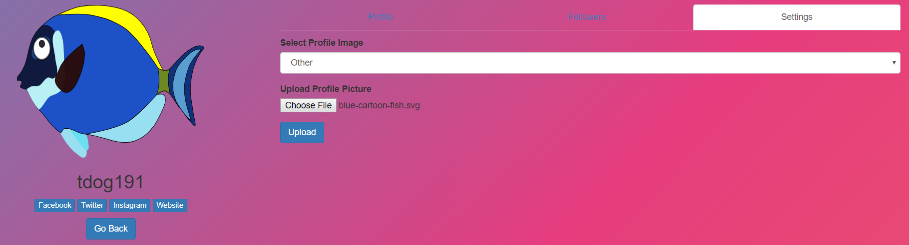
Uploading Profile Pictures
“Upload Profile Picture” Option
Select “Other” from dropdown menu in “Settings tab.
File upload button with “Upload Profile Picture” label and “Upload” button should now appear, and they should disappear after selecting a different option from dropdown menu.
File upload button should bring up File Explorer or similar file upload window
Selecting a file should immediately update the profile picture with the image file.
Select “blue-cartoon-fish.svg” file (or other image file), then click “Upload” button.
Page should refresh with selected picture.
The “Select Profile Image” bar in the “Settings” tab should default to “Other”.
After Selecting Image File

Slide 13

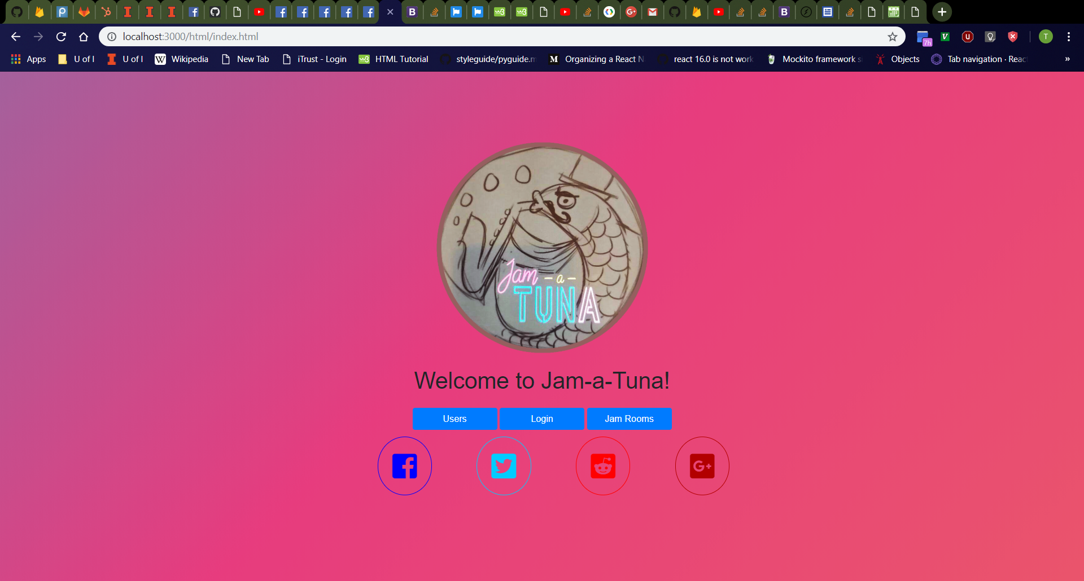
Navigating Back to Home Page
After Clicking “Go Back” on Profile Page
Click “Go Back” on profile page
Should return to “Search Users” page
Click “Go Back” on “Search Users” page
Should return to home page
After Clicking “Go Back” on “Search Users” page

Slide 14
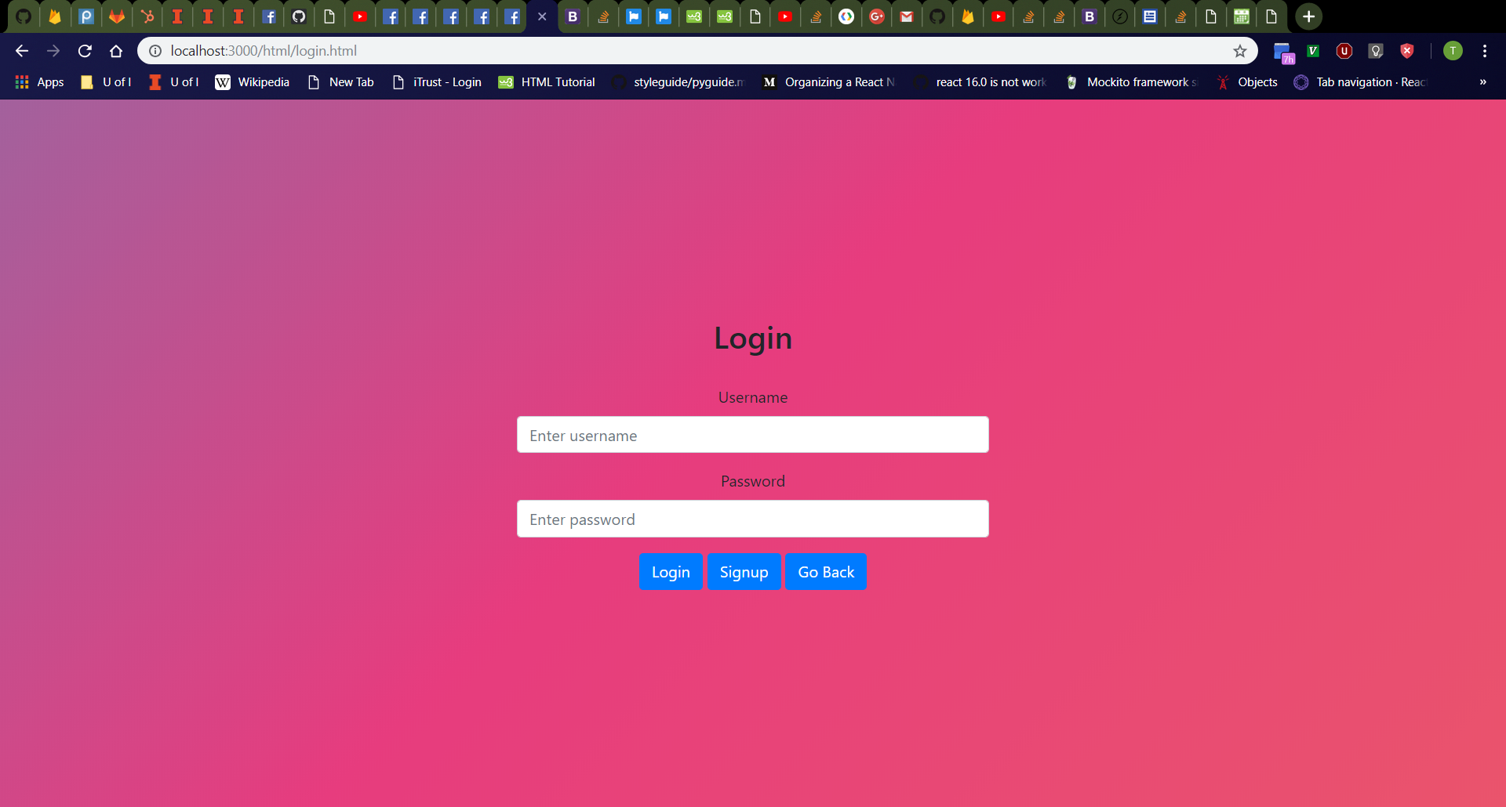
Login Page
Click “Login” button on home page.
Should navigate to http://localhost:3000/html/login.html
From top to bottom; should see “Login” header; username box with label; password box with label; and a row containing a “Login” button, a “Signup” button, and a “Go Back” button from left to right
Username box should be empty with “Enter username” placeholder.
Password box should be empty with “Enter password” placeholder.

Slide 15
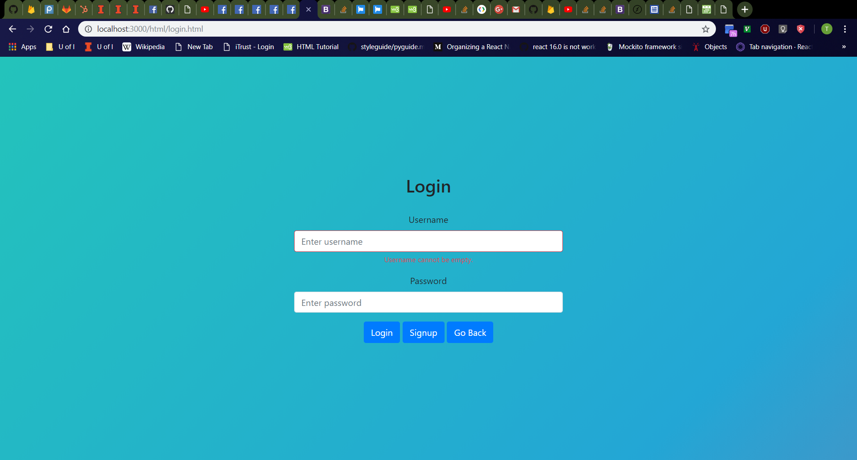

Login Page Error Messages
Click username box, then password box, then click away.
Should see username and password boxes turn red with red “Username cannot be empty.” and “Password cannot be empty.” messages respectively
Refresh the page then click the “Login” button
Should see red error messages again
Validation checks for empty username and password should always occur as user releases keyboard keys, the boxes lose focus, and when the “Login” button is clicked.
Empty Username
Empty Username and Password

Slide 16
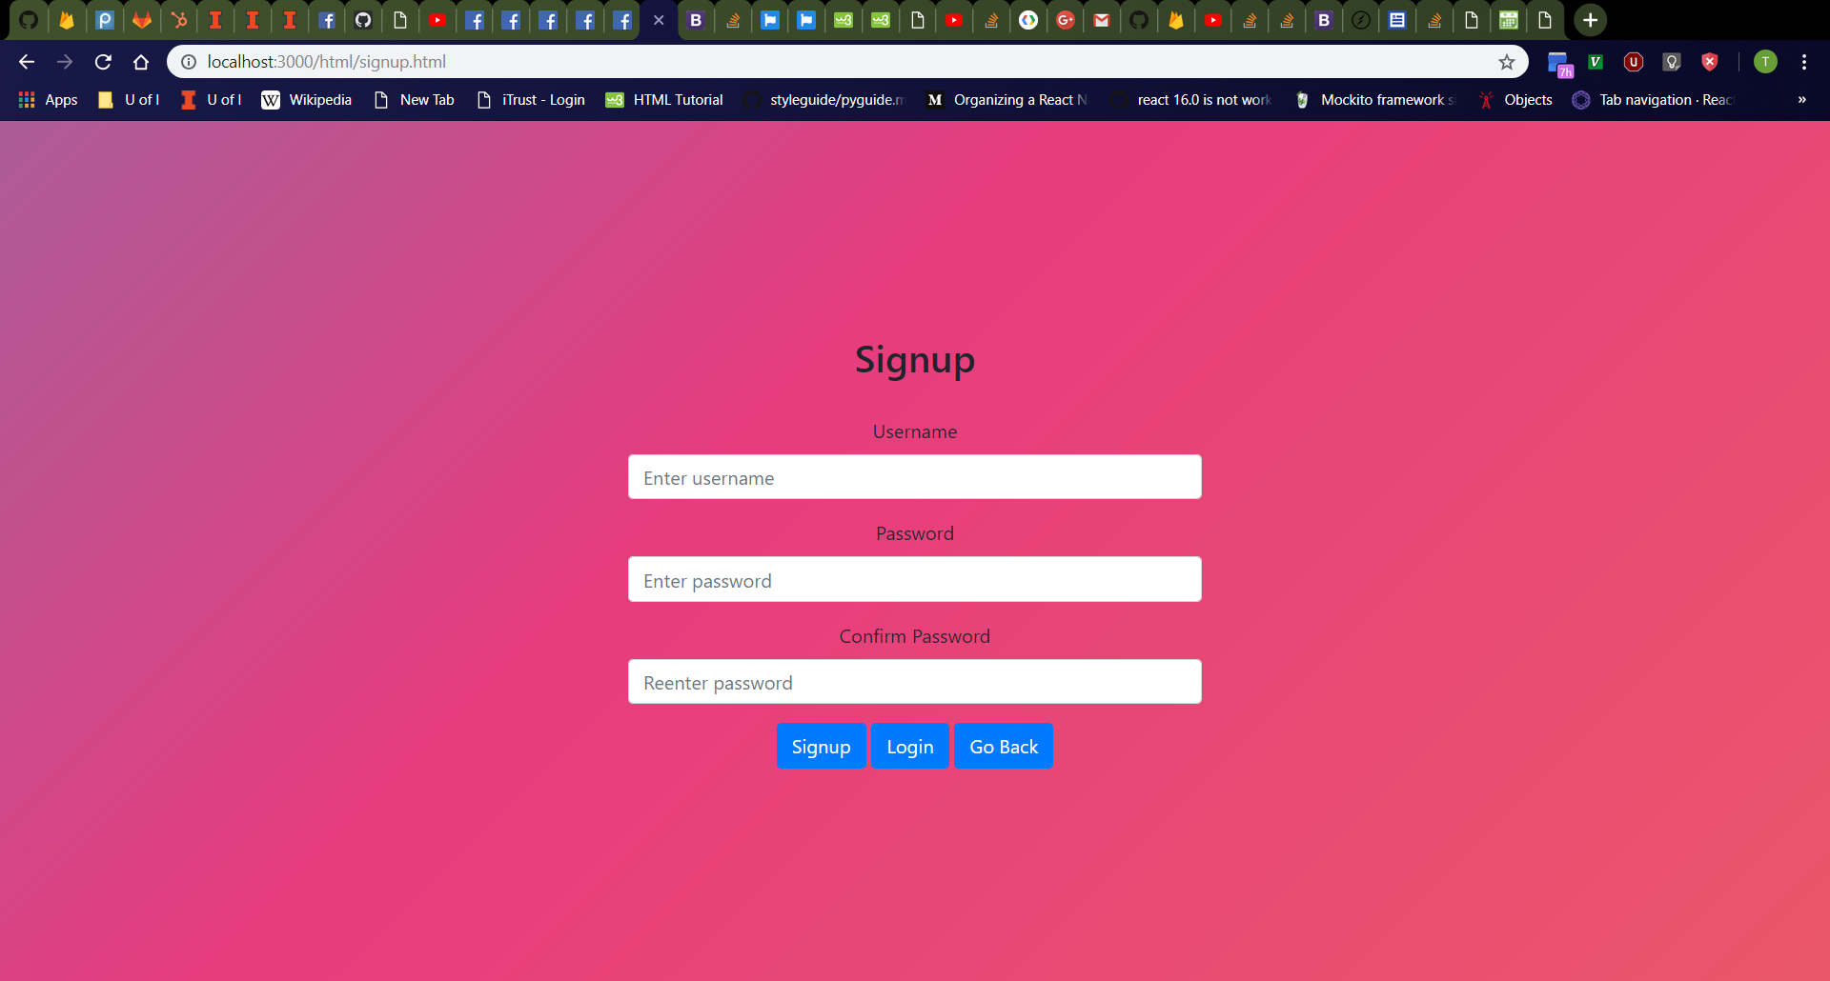
Signup Page
Click “Signup” button on login page.
Should navigate to http://localhost:3000/html/signup.html
From top to bottom; should see “Signup” header; username box with label; password box with label; “Confirm Password” box with label; and a row containing a “Signup” button, a “Login” button, and a “Go Back” button from left to right
Username box should be empty with “Enter username” placeholder.
Password box should be empty with “Enter password” placeholder.
“Confirm Password” box should be empty with “Reenter password” placeholder.

Slide 17
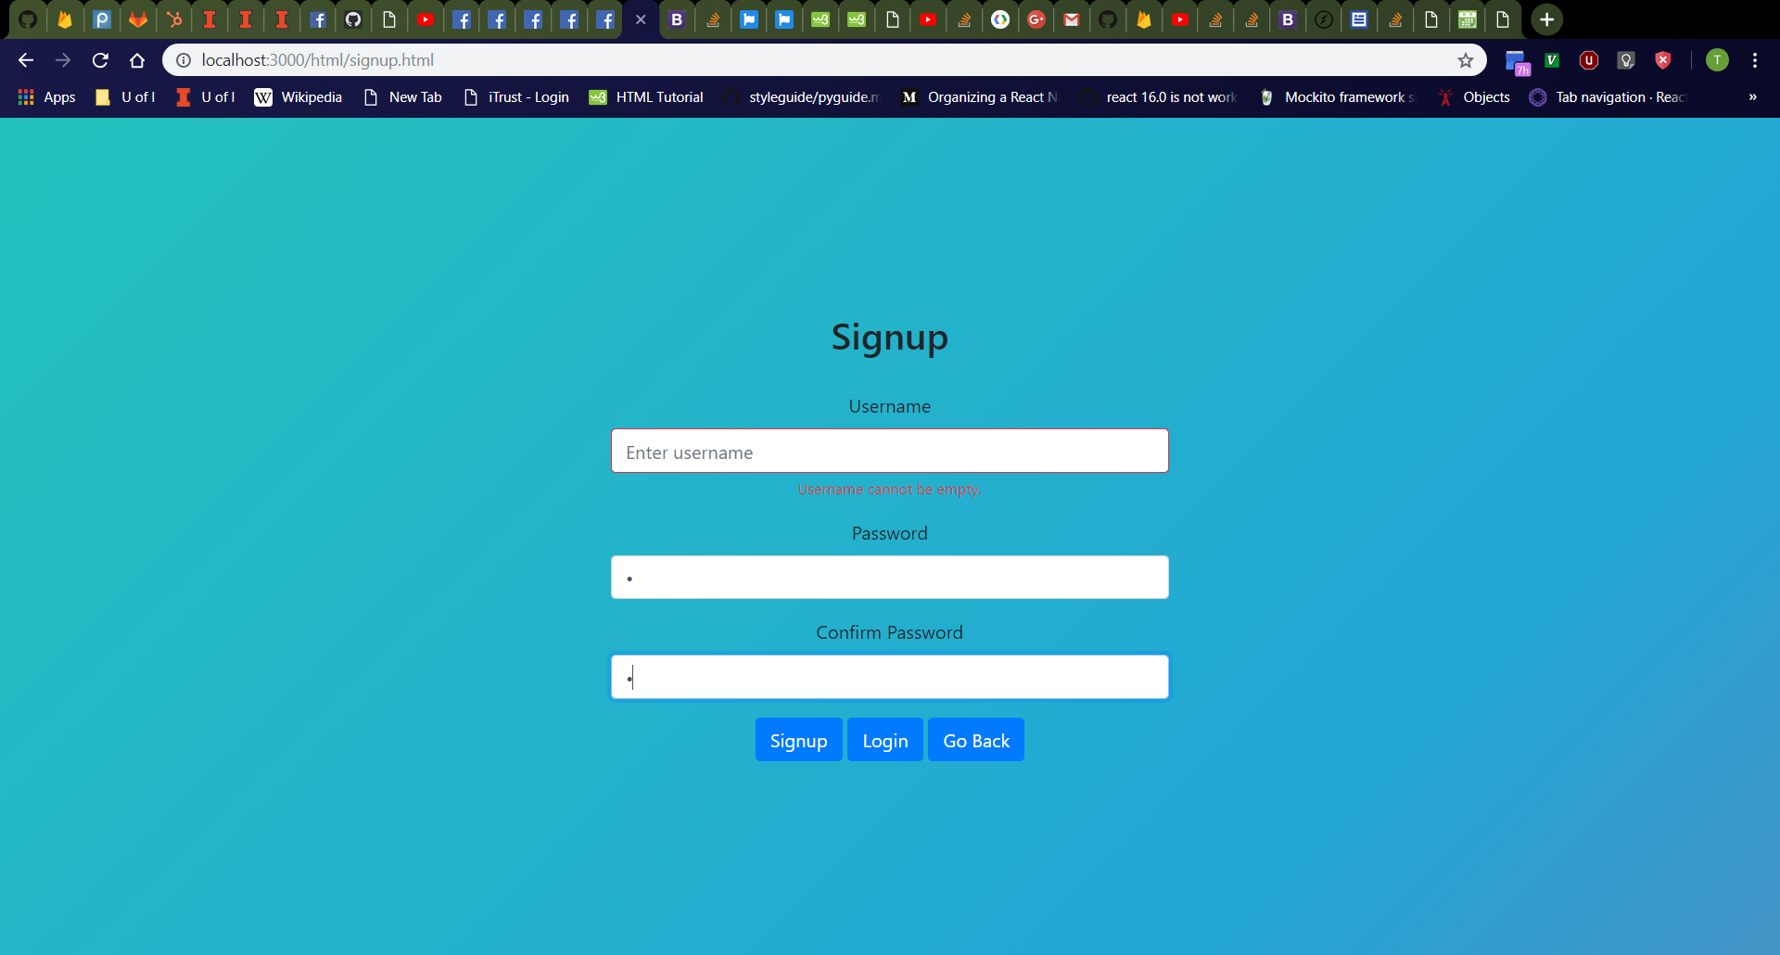
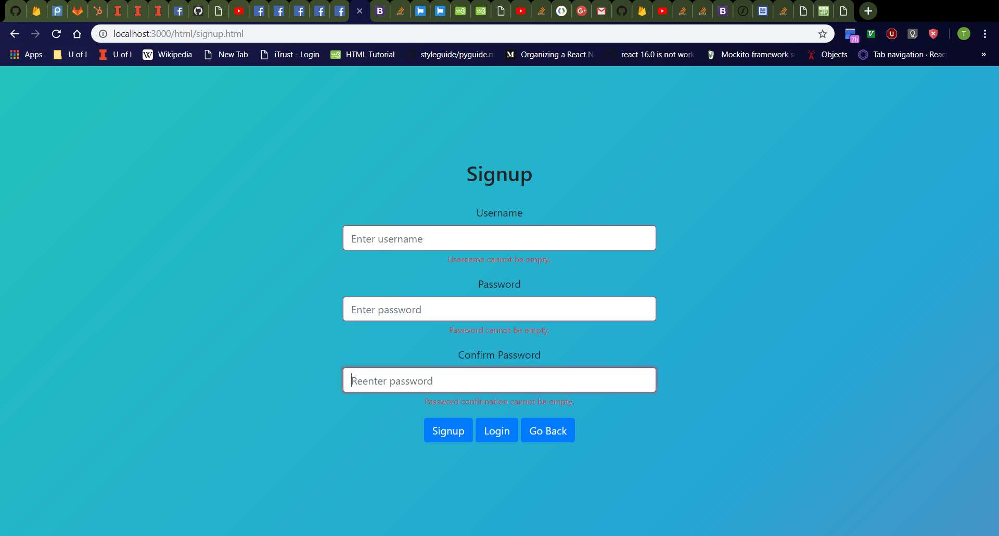
Signup Page Error Messages
Click username box, then password box, then password confirmation box, then click away.
Should see username, password, and password confirmation boxes turn red with red “Username cannot be empty.”, “Password cannot be empty.”, and “Password confirmation cannot be empty.” messages respectively
Refresh the page then click the “Signup” button
Should see red error messages again
Validation checks for empty username, password, and password confirmation should always occur as user releases keyboard keys, the boxes lose focus, and when the “Signup” button is clicked.
Empty Username and Identical Password and Password Confirmation
All boxes empty

Slide 18
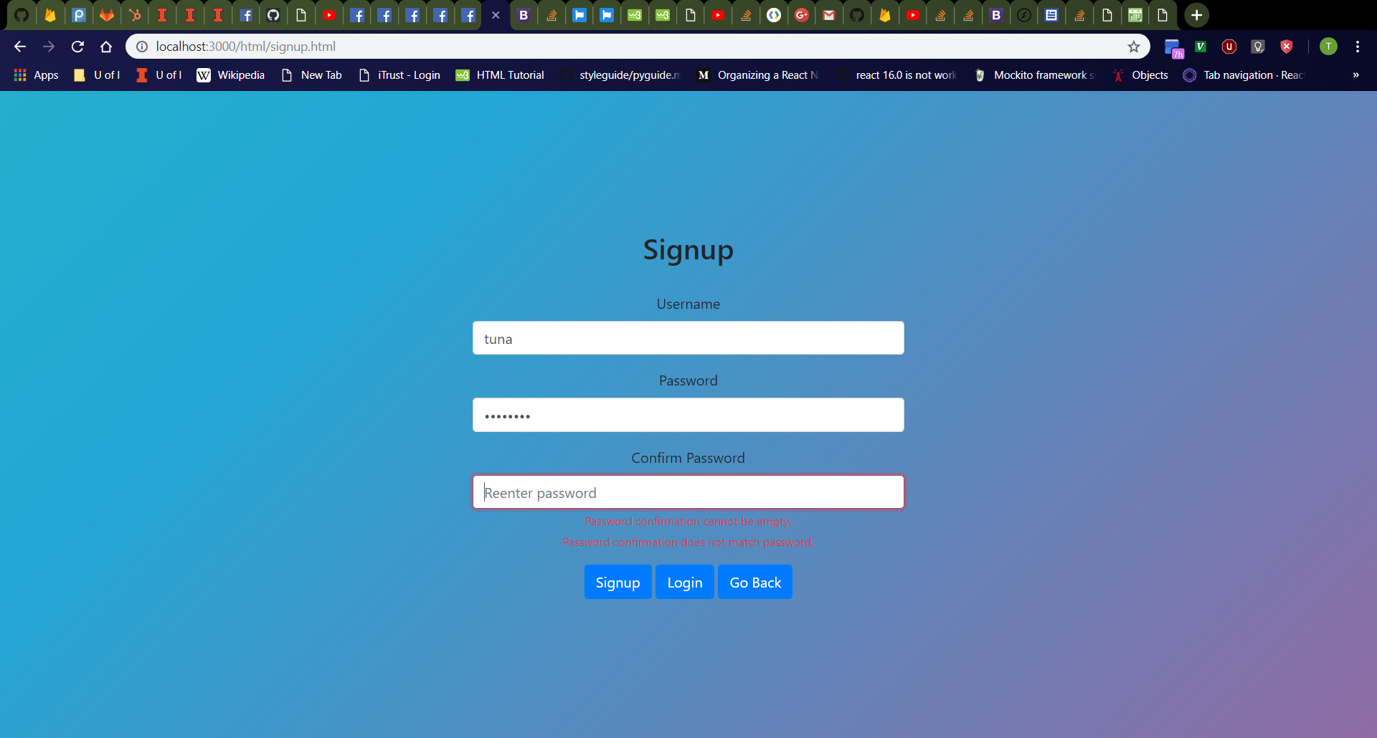
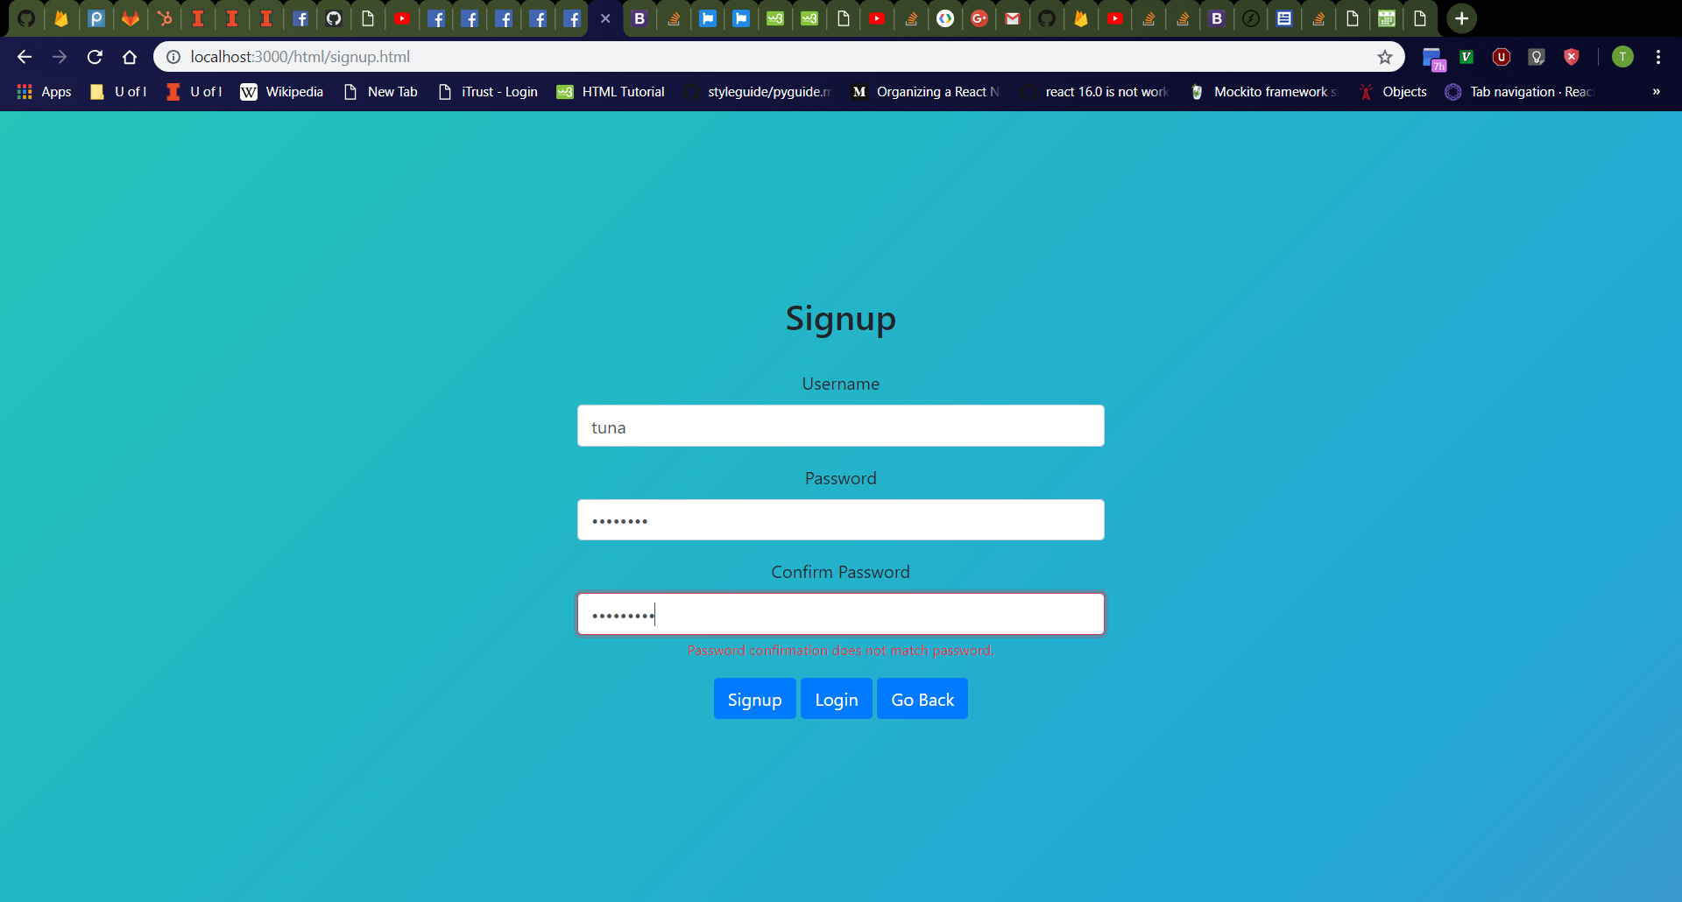
Signup Page Error Messages Cont.
Type “tuna” in username, “password” in password, and click password confirmation box.
Should see password confirmation box turn red with red “Password confirmation cannot be empty.” and “Password confirmation does not match password.” messages below
Type “password2” in password confirmation box
Should still see red “Password confirmation does not match password.” message
Password and Empty Password Confirmation
Unidentical Passwords

Slide 19
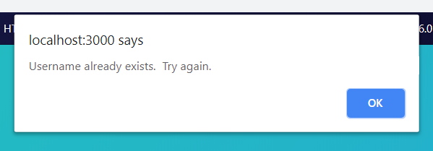
Signup Page (Username Already Exists)
Enter the following values in the signup page:
Username: “tdog191” (or other existing username in database)
Password: “password”
Confirm Password: “password”
Should see alert dialog box in browser with message “Username already exists. Try again.”

Slide 20
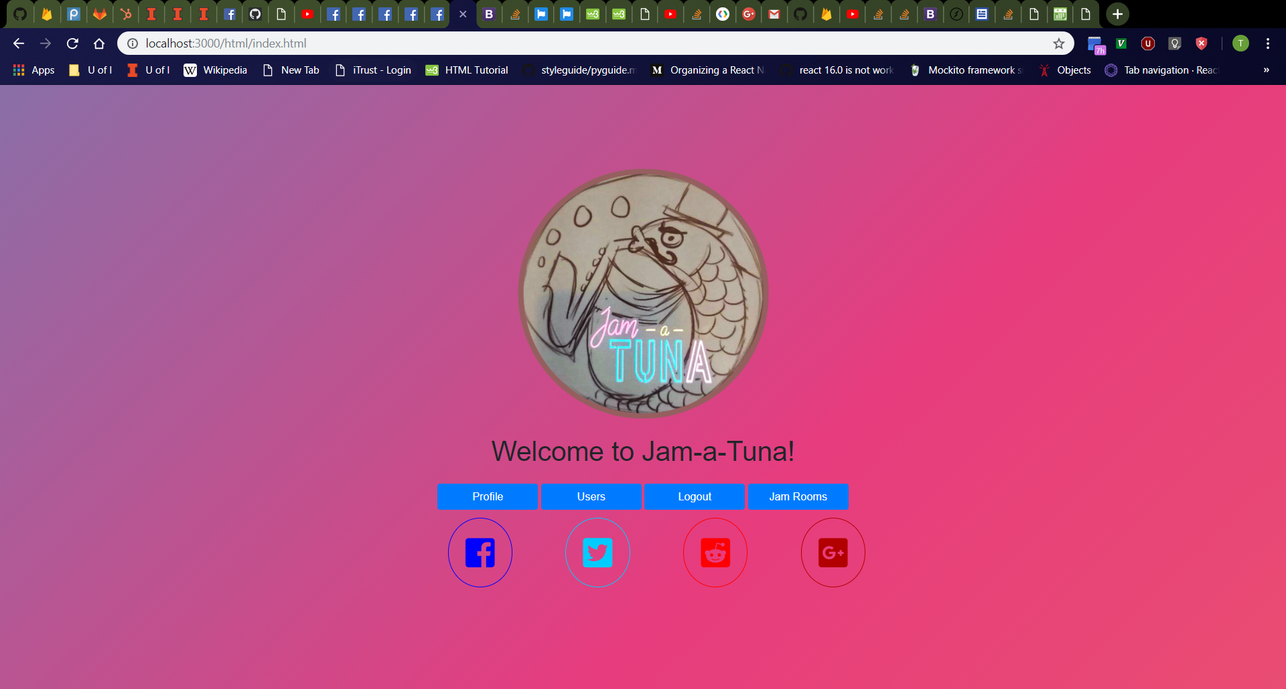
Signup Page (Success)
Click “OK” button to close alert dialog box
Enter the following values in the signup page:
Username: “tuna” (or other nonexistent username in database)
Password: “password”
Confirm Password: “password”
Should be redirected to home page, which now displays a “Logout” button instead of a “Login” button and also a “Profile” button because a login happened

Slide 21
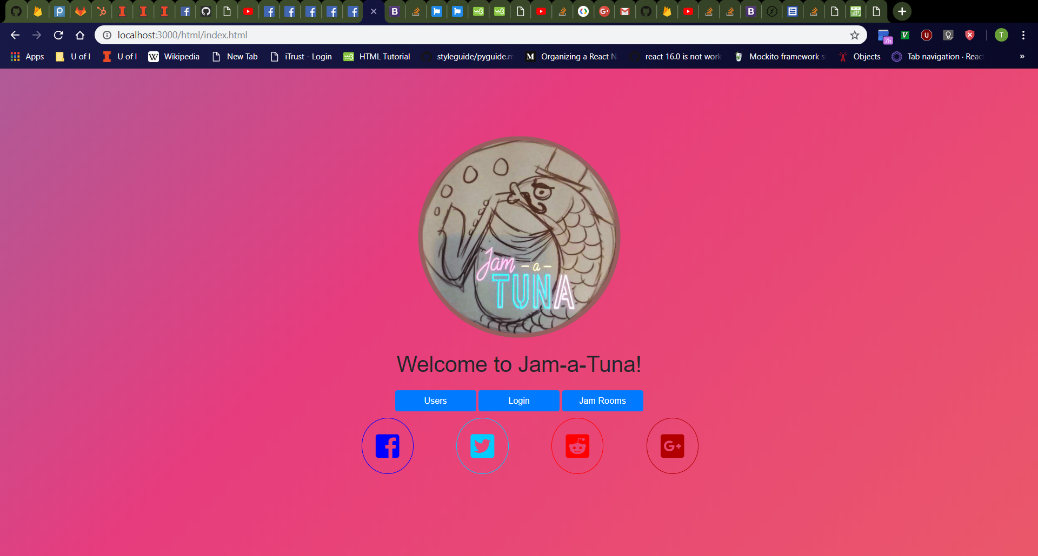
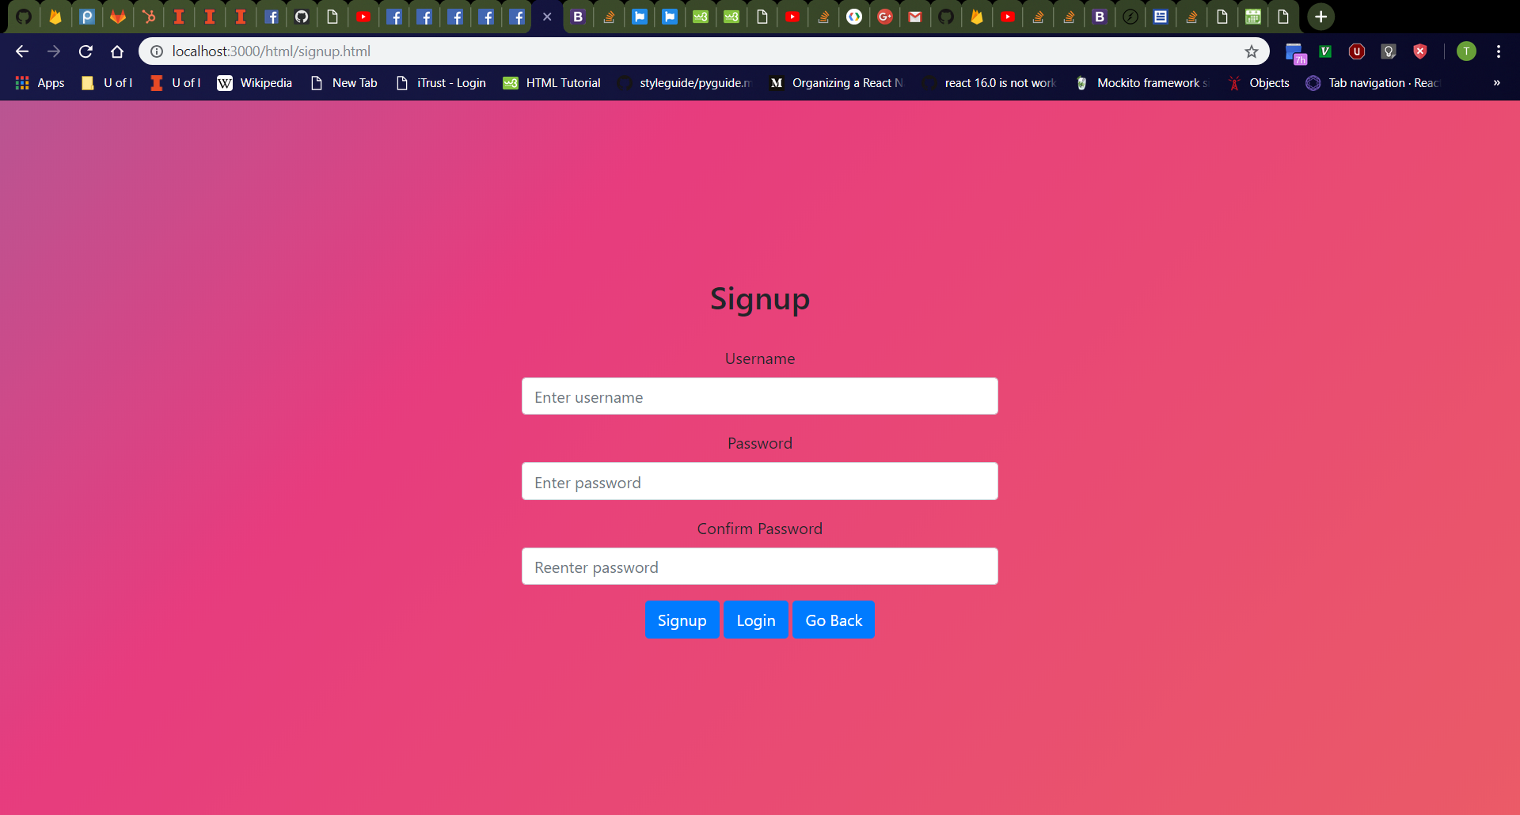

Navigate Back To Home Page from Signup Page
After Clicking “Logout” button
Click “Logout” button and redisplay original homepage
Click on “Login” button then “Signup” button to return to Signup page
Click “Go Back” button on Signup page
Should return to homepage
Navigating Back to Signup Page
After Clicking “Go Back” Button on Signup Page

Slide 22
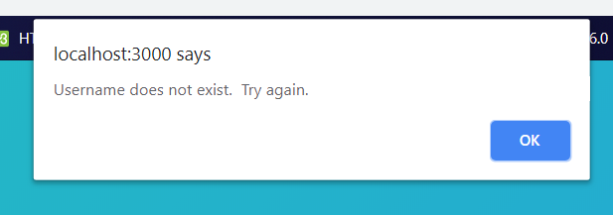
Login Page (Username Does Not Exist)
Click “Login” button on homepage
Should navigate to http://localhost:3000/html/login.html
Enter the following values in the login page:
Username: “tuna2” (or other nonexistent username in database)
Password: “password”
Should see alert dialog box in browser with message “Username does not exist. Try again.”

Slide 23
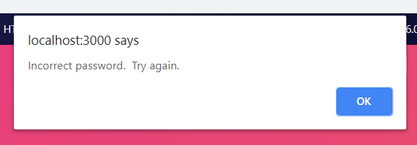
Login Page (Incorrect Password)
Click “OK” button to close alert dialog box
Enter the following values in the login page:
Username: “tuna” (or other existing username in database)
Password: “password2” (or other incorrect password)
Should see alert dialog box in browser with message “Incorrect password. Try again.”

Slide 24
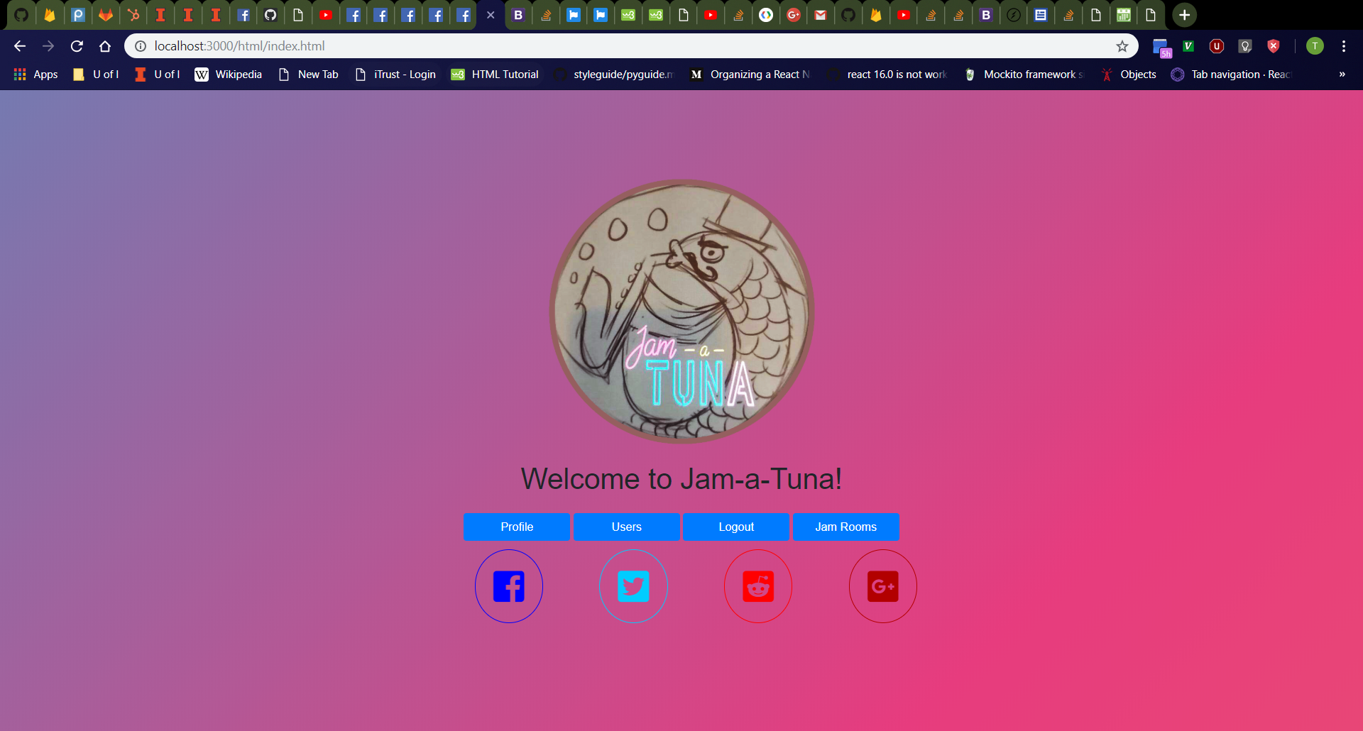
Login Page (Success)
Click “OK” button to close alert dialog box
Enter the following values in the login page:
Username: “tuna” (or other existing username in database)
Password: “password” (or which password is correct)
Should be redirected to home page, which now displays a “Logout” button instead of a “Login” button and also a “Profile” button because a login happened

Slide 25
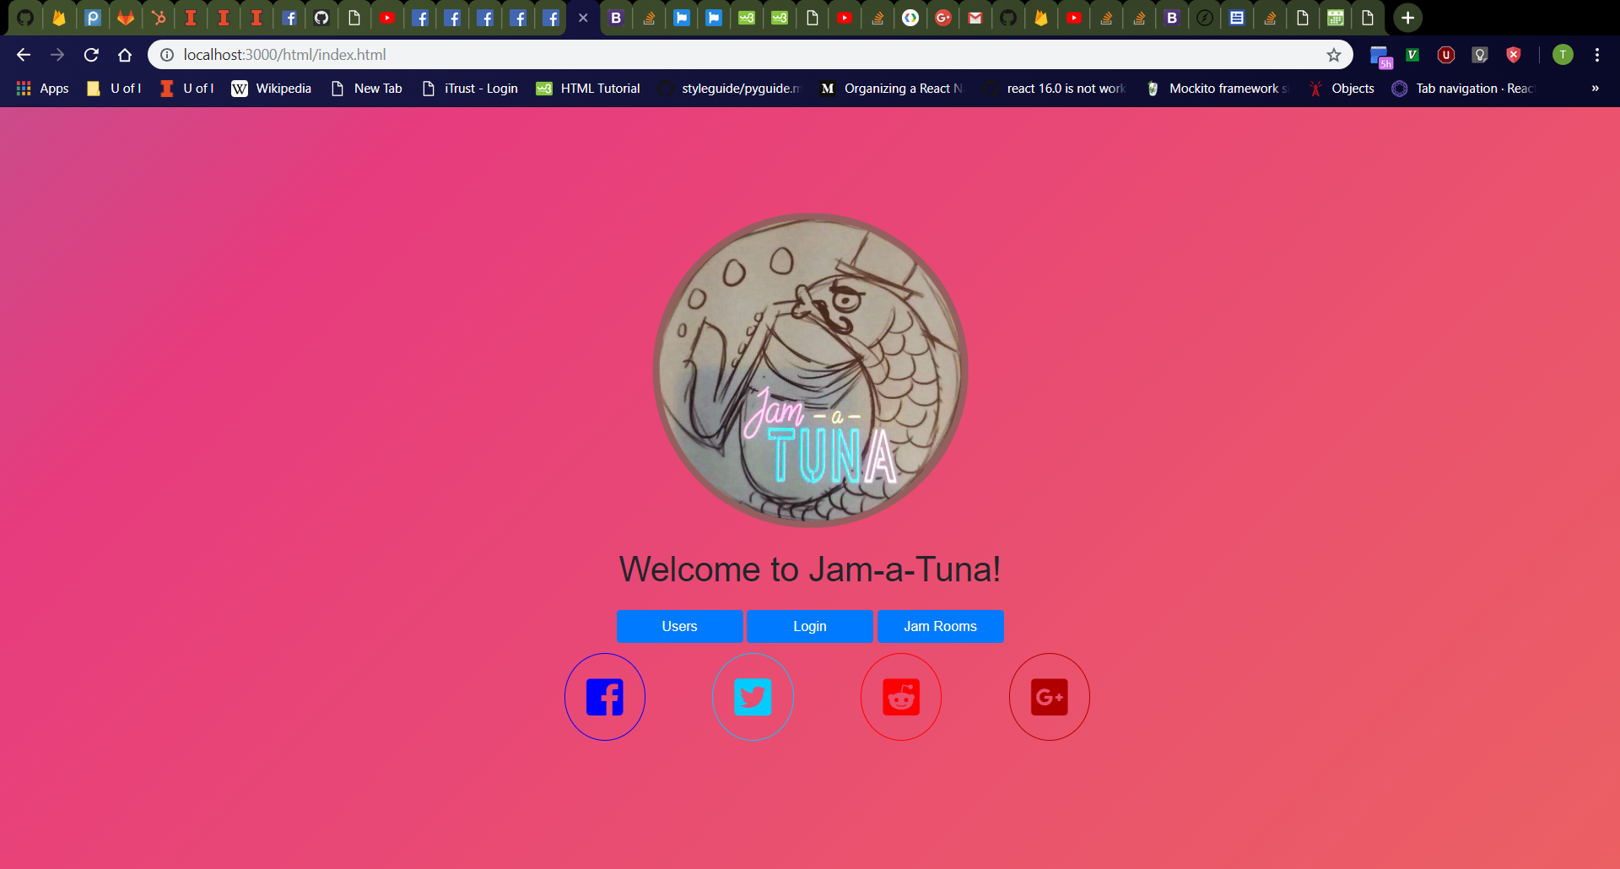
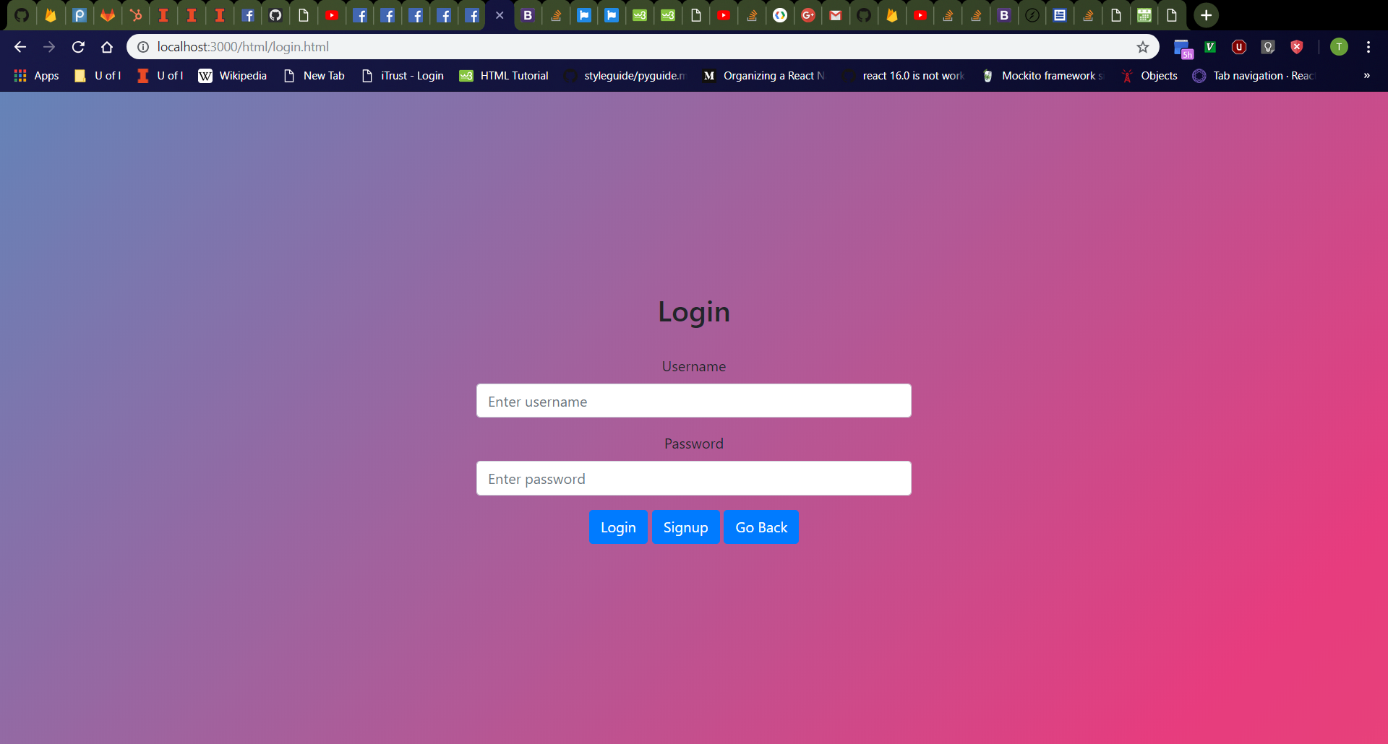

Navigate Back To Home Page from Login Page
After Clicking “Logout” button
Click “Logout” button and redisplay original homepage
Click on “Login” button to return to Login page
Click “Go Back” button on Login page
Should return to homepage
Navigating Back to Login Page
After Clicking “Go Back” Button on Login Page

Slide 26

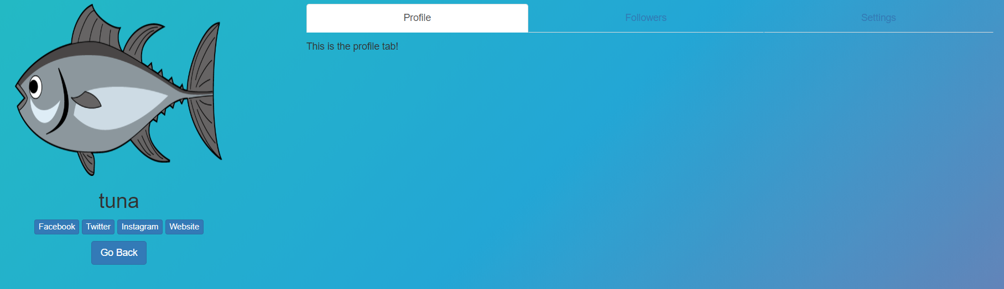

Home Page (After Login)
New Home Page
Click on “Login” button to return to Login page
Enter the following values in the login page:
Username: “tuna” (or other existing username in database)
Password: “password” (or which password is correct)
Should navigate to http://localhost:3000/html/index.html
Should see JamATuna homepage from before, now with a “Profile” and “Logout” buttons and no “Login” button because a login happened
Click on “Profile” button
Should navigate to profile page of logged-in user (“tuna” in example to the right)
Click “Go Back” button
Should redirect to homepage
Click on “Logout” button
Should refresh to display old home page
Profile Page of Logged-In User
Old Home Page

Slide 27
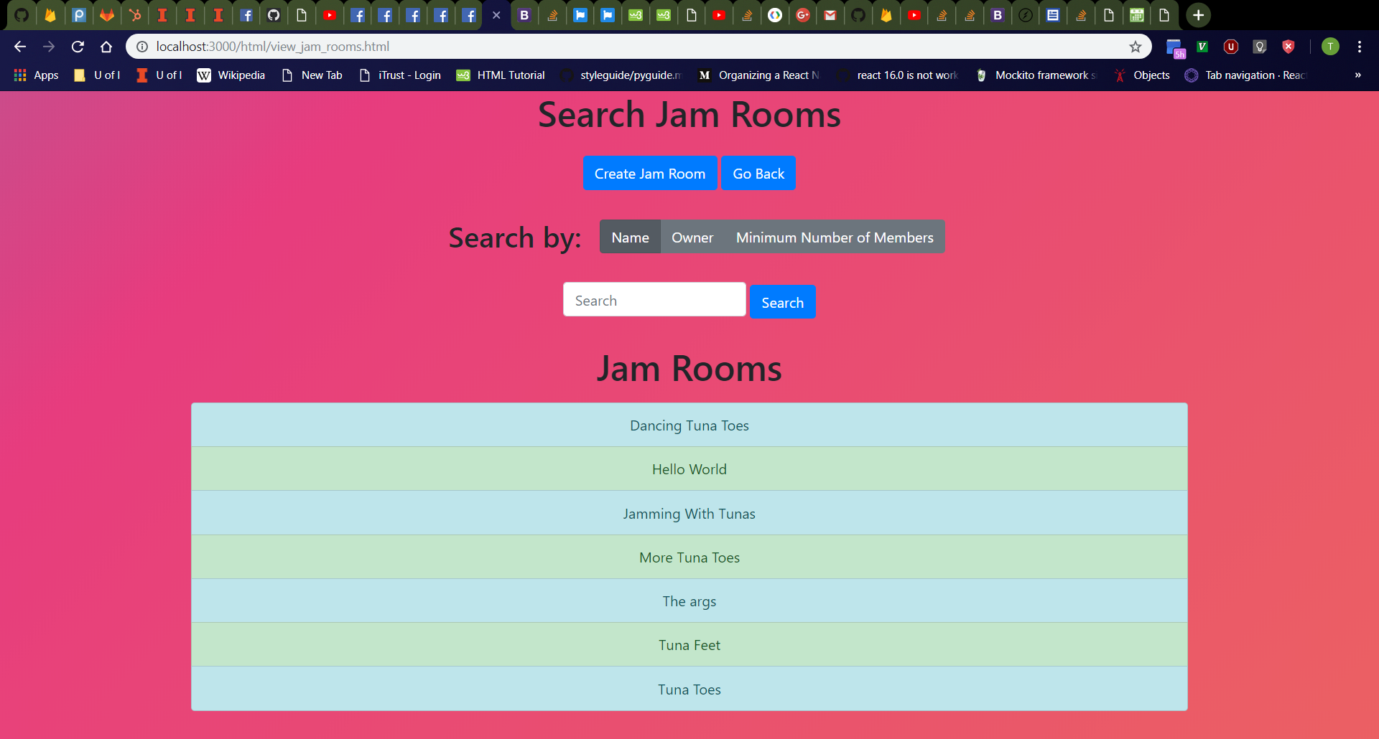
Jam Rooms Page
Click “Jam Rooms” button on home page.
Should navigate to http://localhost:3000/html/view_jam_rooms.html
From top to bottom; should see “Search Jam Rooms” header; a row containing a “Create Jam Room” button and a “Go Back” button from left to right; a row containing a “Search by:” header and “Home”, “Owner“, and “Minimum Number of Members” radio buttons from left to right; a row containing a search bar and a “Search” button from left to right; a “Jam Rooms” header; and a list of all jam rooms in the database
“Home” radio button should be toggled by default.
Search bar should be empty with “Search” placeholder.
Odd-numbered list entries should be colored light-blue while even-numbered entries are colored light-green.

Slide 28
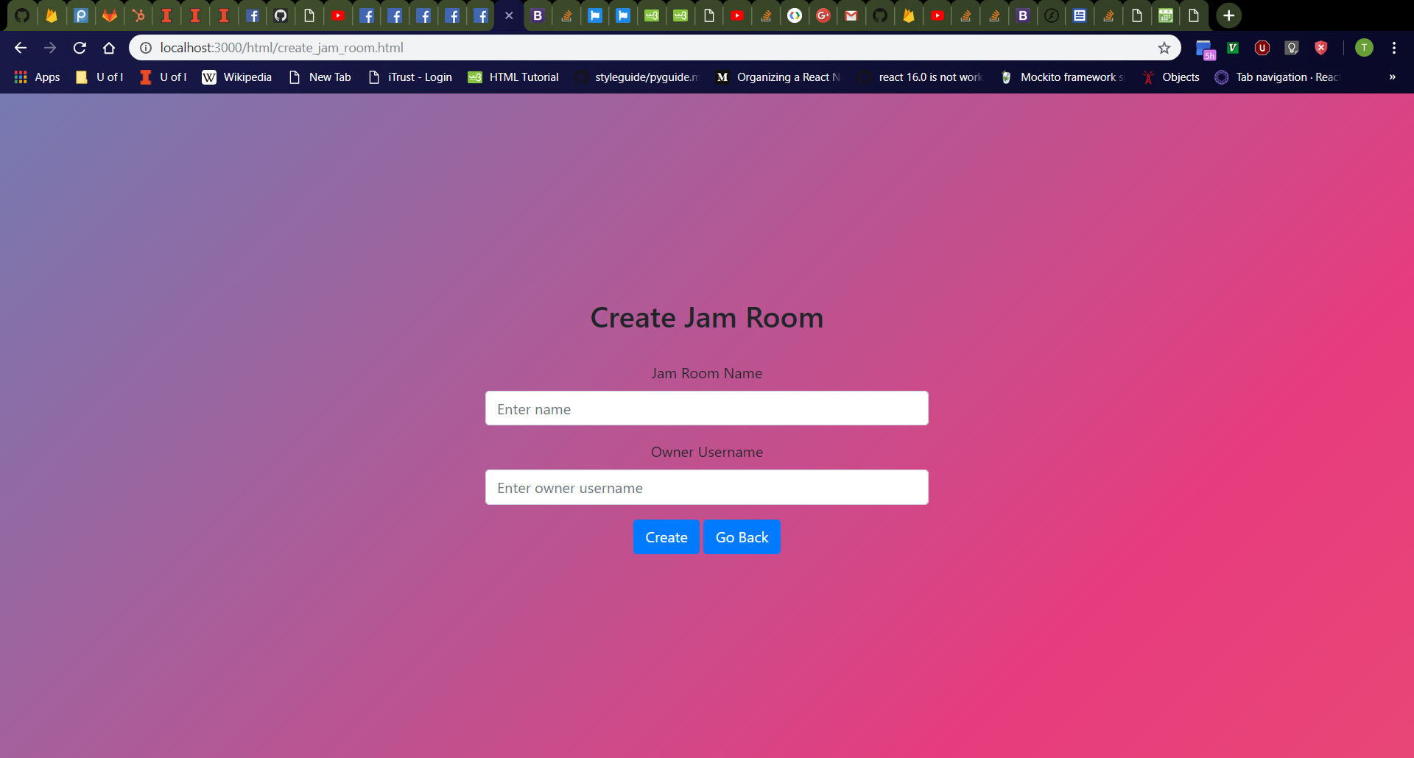
Create Jam Room Page
Click “Create Jam Room” button on “Search Jam Rooms” page.
Should navigate to http://localhost:3000/html/create_jam_room.html
From top to bottom, should see “Create Jam Room” header, jam room name box with label, owner username box with label, then a row containing a “Create” button and a “Go Back” button from left to right
Jam room name box should be empty with “Enter name” placeholder.
Owner username box should be empty with “Enter owner username” placeholder.

Slide 29
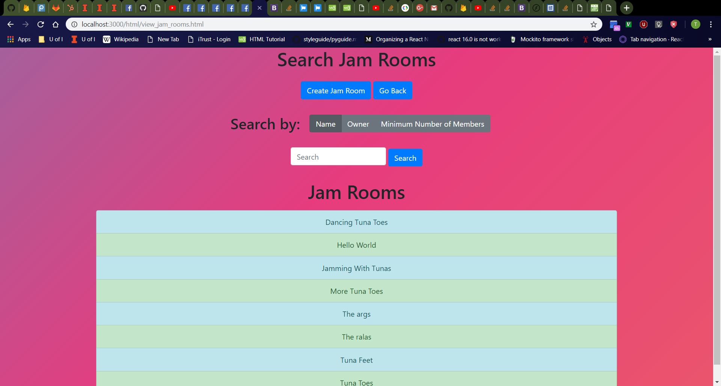
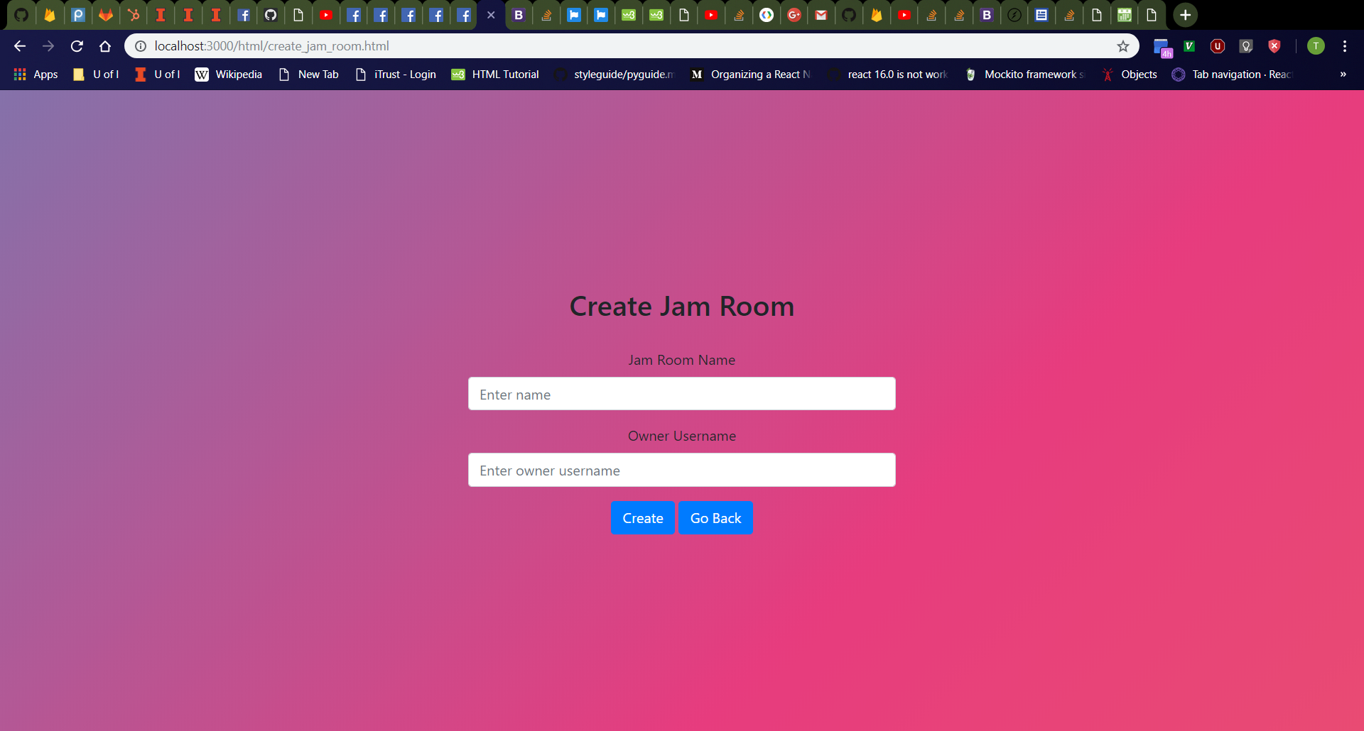
Navigate Back To Jam Rooms Page from Jam Room Creation Page
After Clicking “Go Back” Button on Jam Room Creation Page
Click “Go Back” button on jam room creation page.
Should return to jam room search page
Click “Create Jam Room” button to return to the jam room creation page.
After Clicking “Create Jam Room” Button on “Search Jam Rooms” Page

Slide 30
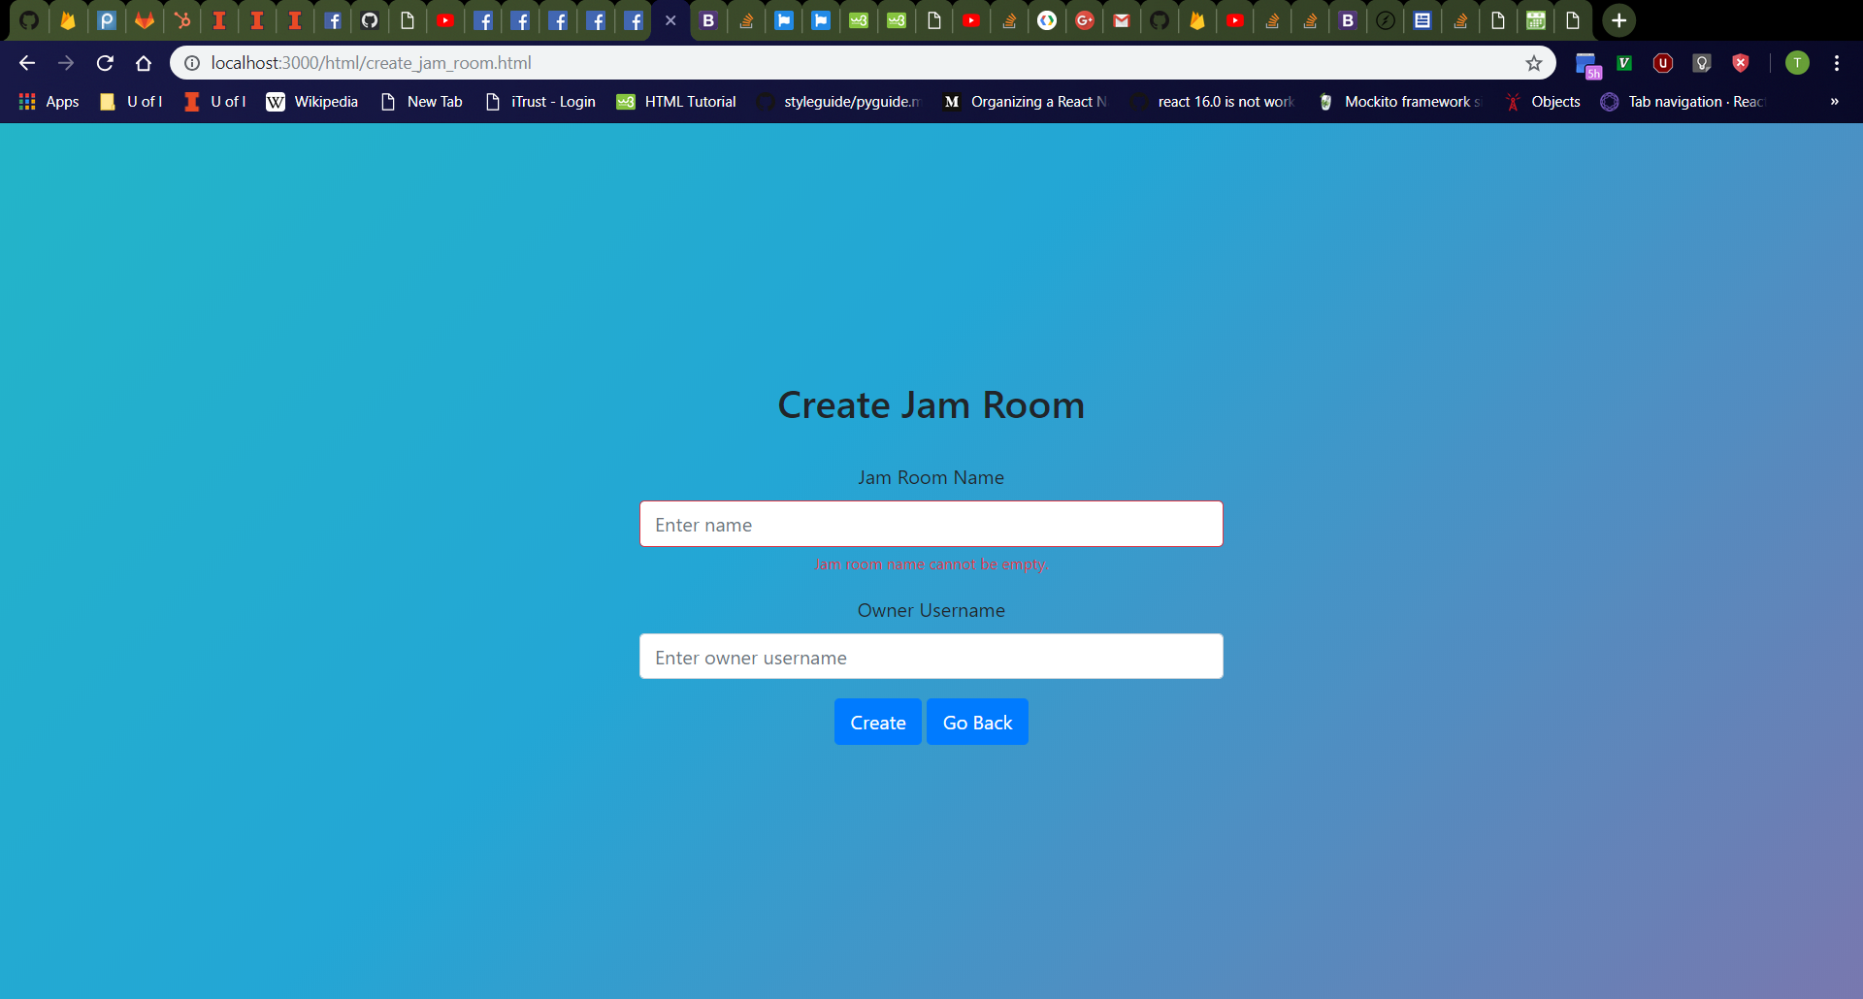

Create Jam Room Page Error Messages
Click jam room name box, then owner username box, then click away.
Should see jam room name and owner username boxes turn red with red “Jam room name cannot be empty.” and “Owner username cannot be empty.” messages respectively
Refresh the page then click the “Create” button
Should see red error messages again
Validation checks for empty jam room name and owner username boxes should always occur as user releases keyboard keys, the boxes lose focus, and when the “Create” button is clicked.
Empty Jam Room Name
All boxes empty

Slide 31
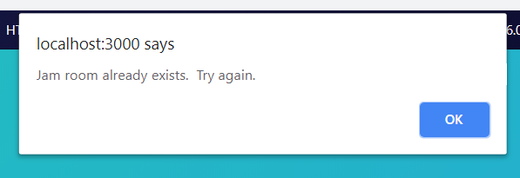
Create Jam Room Page (Jam Room Already Exists)
Enter the following values in the jam room creation page:
Jam Room Name: “More Tuna Toes” (or other existing jam room in database)
Owner Username: “tdog191”
Should see alert dialog box in browser with message “Jam room already exists. Try again.”

Slide 32
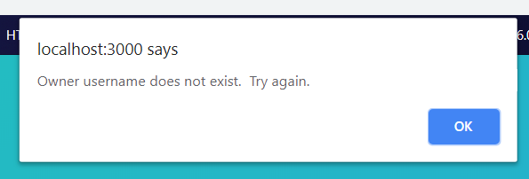
Create Jam Room Page (Owner Username Does Not Exist)
Click “OK” button to close alert dialog box
Enter the following values in the jam room creation page:
Jam Room Name: “Dancing Tuna Feet” (or other nonexistent jam room in database)
Owner Username: “salt” (or other nonexistent user in database)
Should see alert dialog box in browser with message “Owner username does not exist. Try again.”

Slide 33
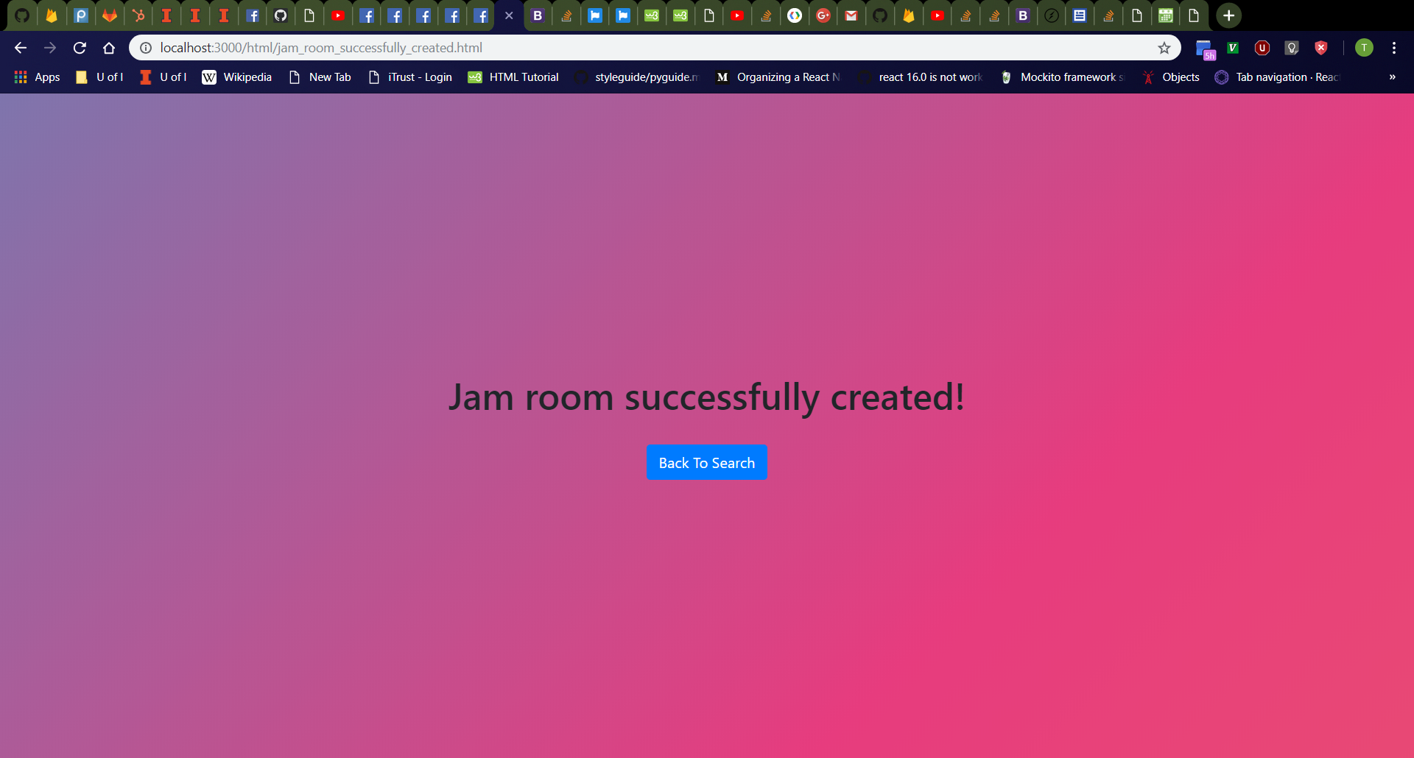
Create Jam Room Page (Success)
Click “OK” button to close alert dialog box
Enter the following values in the jam room creation page:
Jam Room Name: “Dancing Tuna Feet” (or other nonexistent jam room in database)
Owner Username: “tdog191” (or other existing user in database)
Should see new page with message “Jam room successfully created!” and “Back To Search” button.

Slide 34
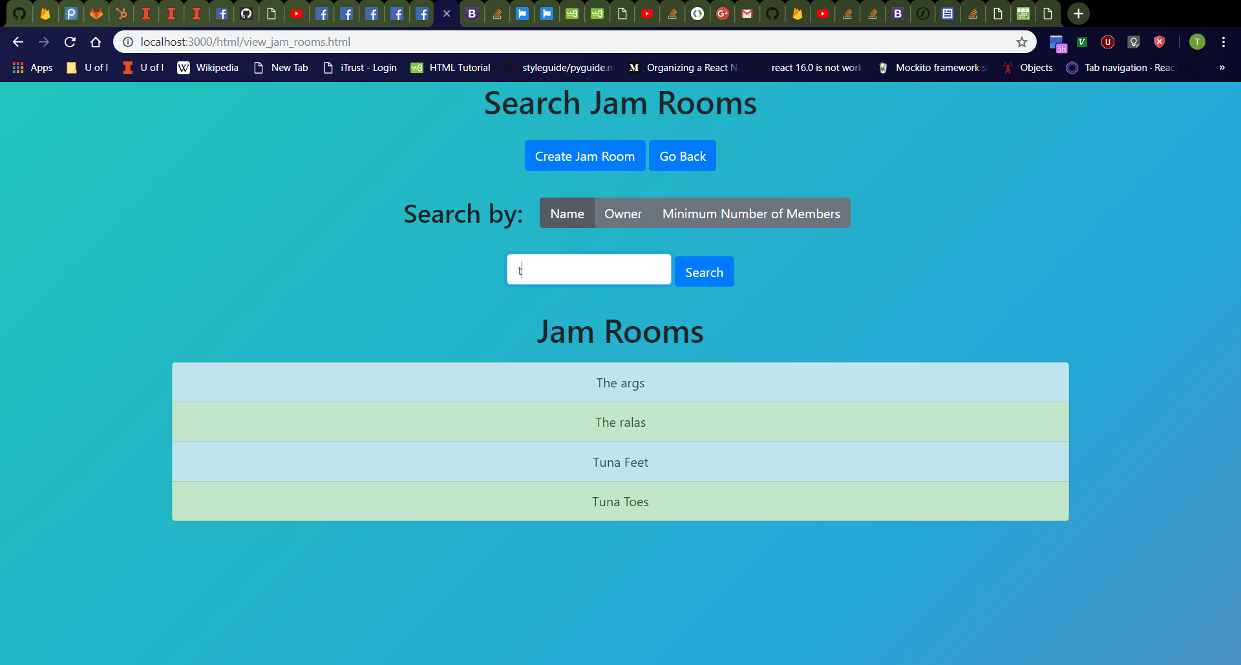
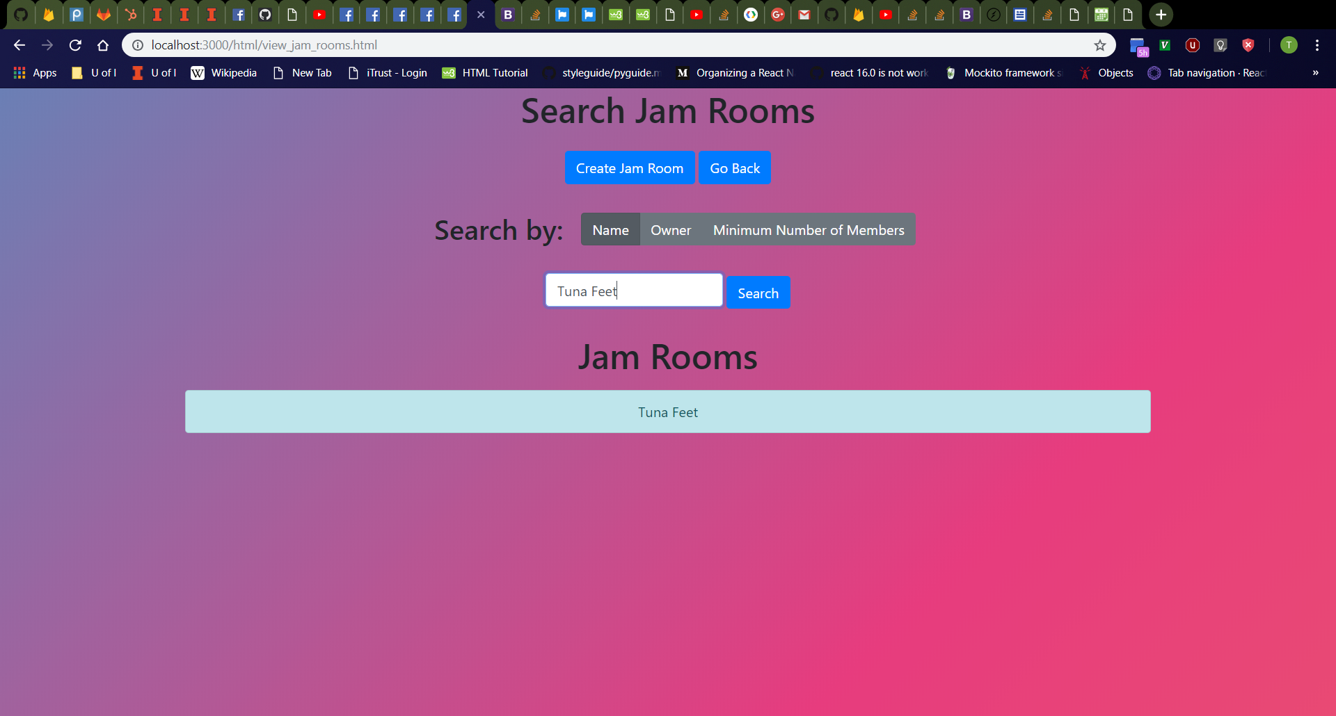
Jam Room Search (Search by Name)
First Search
Click “Back To Search” button
Should navigate to http://localhost:3000/html/view_jam_rooms.html
Enter “t” (or other prefix (ignoring case) of a jam room in the list) into search bar and click “Search” button.
Jam room list should only display jam rooms in database with matching name prefixes (ignoring case)
Odd-numbered entries should still be colored light-blue while even-numbered entries should still be colored light-green.
Enter “Tuna Feet” (or other jam room in database) into search bar and click “Search” button.
Old search results should disappear, and the new search results should be displayed.
Second Search

Slide 35
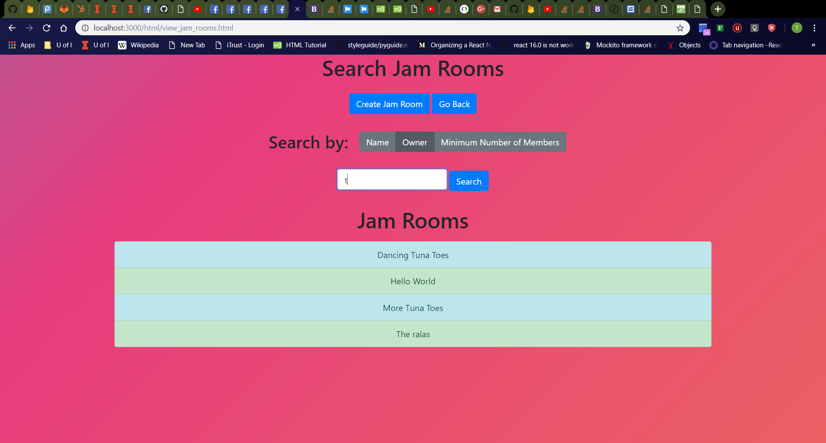

Jam Room Search (Search by Owner)
First Search
Click “Owner” radio button to toggle on search by jam room owner
Enter “t” (or other prefix (ignoring case) of a jam room owner username in the database) into search bar and click “Search” button.
Jam room list should only display jam rooms in database with owners that have usernames with matching prefixes (ignoring case)
Odd-numbered entries should still be colored light-blue while even-numbered entries should still be colored light-green.
Enter “tdog191” (or other jam room owner username in database) into search bar and click “Search” button.
Old search results should disappear, and the new search results should be displayed.
Second Search

Slide 36


Jam Room Search (Search by Minimum Number of Members)
First Search
Click “Minimum Number of Members” radio button to toggle on search by minimum number of members
Enter “1” into search bar and click “Search” button.
Should see list of all jam rooms in database (since every jam room has its owner as a member, thereby meeting the minimum number of members 1)
Odd-numbered entries should still be colored light-blue while even-numbered entries should still be colored light-green.
Enter “2” into “Search by Minimum Number of Members” bar and click “Search” button immediately below.
Jam room list should only display jam rooms in database with at least two members.
Old search results should disappear, and the new search results should be displayed.
Second Search

Slide 37


Navigate Back To Home Page from Jam Rooms Page
After Clicking “Go Back” Button on Jam Rooms Page
Click “Go Back” button on jam rooms page.
Should return to homepage
Click “Jam Rooms” button to return to the jam rooms page.
After Clicking “Jam Rooms” Button on Home Page

Slide 38

Join Jam Room Page
Click “Tuna Feet” (or other search result entry on “Jam Rooms” page).
Should navigate to http://localhost:3000/html/join_jam_room.html
From top to bottom, should see “Join Jam Room” header, username box with label, then a row containing “Join” button and a “Go Back” button from left to right
Username box should be empty with “Enter username” placeholder.

Slide 39


Navigate Back To Jam Rooms Page from Jam Room Joining Page
After Clicking “Go Back” Button on Jam Room Joining Page
Click “Go Back” button on jam room joining page.
Should return to jam room search page
Click “Tuna Feet” (or other search result entry on “Jam Rooms” page) to return to the jam room joining page.
After Clicking “Tuna Feet” Entry on “Search Jam Rooms” Page

Slide 40

Join Jam Room Page Error Messages
Click username box, then click away.
Should see username box turn red with red “Joiner username cannot be empty.” message
Refresh the page then click the “Join” button
Should see red error message again
Validation check for empty username box should always occur as user releases keyboard keys, the boxes lose focus, and when the “Join” button is clicked.
Empty Username

Slide 41

Join Jam Room Page (Joiner Username Does Not Exist)
Enter “salt” (or other nonexistent user in database) in username box.
Should see alert dialog box in browser with message “Username does not exist. Try again.”

Slide 42

Join Jam Room Page (Success)
Click “OK” button to close alert dialog box.
Enter “tdog191” (or other existing user in database) in username box.
Should be redirected to the jam room’s home page (“Tuna Feet” in the example to the right)

Slide 43


Jam Room Page
Jam Room Page
Jam Room Page
Should have URL http://localhost:3000/html/jam_room.html
From top to bottom, should see “Welcome to <name of jam room>!” header, “Owner” header, clickable light-blue rectangle containing the username of the jam room’s owner, “Members” header, list of all members in the jam room, then a row containing “Chat”, “Audio”, and “Go Back” buttons from left to right
Should see Facebook, Twitter, Reddit, and Google+ icons that work by sharing the website to social media
Odd-numbered entries of the members list should be colored light-blue while even-numbered entries are colored light-green.
Click any user entry on the page
Should navigate to corresponding user’s profile page
After Selecting User

Slide 44


Navigate Back To Jam Rooms Page from Jam Room Page
After Clicking “Go Back” Button on Jam Room Page
Click “Go Back” button on jam room page.
Should return to jam room search page
Rejoin “Tuna Feet” (or other search result entry on “Jam Rooms” page) to return to the jam room page.
After Rejoining “Tuna Feet” Jam Room

Slide 45

Chat Page
Click “Chat” button on jam room page.
Should navigate to http://localhost:3000/html/chat.html
From left to right at the bottom of the page, should see username box, message box, then “Send” button
Username box should be empty with “Enter username” placeholder.
Message box should be empty with “Enter message” placeholder.

Slide 46



Chat Page Cont.
Open chat page in two browser tabs.
Type username and messages into either tab and hit ‘Enter’.
Messages should show on both tabs.
Every sent message should be of the form “<username>: <message>”.
Every odd-numbered message should have a gray background.
Message box should become empty after a message is sent.
Messages should not appear to any user outside the jam room.

Slide 47

Chat Page Example
Step 1
Step 2
Step 4
Step 3

Slide 48

Reloading Chat Page
Refresh the chat page
Should see chat messages reload onto the screen

Slide 49

Audio Page
Return to jam room page and click “Audio” button
Should navigate to http://localhost:3000/html/audio.html
Loading screen should appear first.
Should see audio page thereafter
Drum beat should start.
Check layout
Jam room title appears
Home and Back button appear
HTML5 Canvas appear
Gain knobs appear
Pan knobs appear
Drum toggles appear

Slide 50
Audio Page Cont.
Test buttons
Home returns to home page
Back returns to last page
Test toggles
Turn on and off hats
Turn on and off shakers
Turn on and off congas

Slide 51

Audio Page Cont.
Test canvas
Entering canvas, mouse pointer changes to hand
Leaving canvas, mouse pointer changes back to default
Hovering over a button tile will change its brightness
Smooth fade in and fade out

Slide 52
Audio Page Cont.
Test canvas con.
Clicking a button tile will produce a sound
Hold clicking a button tile will repeatedly produce sounds
Every sound will be on the beat playing 1/8 notes
Holding left click while moving to other tiles will continue to produce sounds
Hold click will persist even if canvas is exited

Slide 53
Audio Page Cont.
Test encoders
Gain knob will change corresponding column’s gain
Logarithmic scaling
Pan knob will change corresponding column’s pan position
Left and right sounding
After changing the gain and pan, play sounds for the corresponding column
Should sound as expected

Slide 54


Audio Page Cont.
Tab 1
Test multiplayer
Open two tabs (Tab 1, Tab 2)
Clicking on a button tile in Tab 1 will make a sound play in Tab 2 as well as the corresponding tile pulse white
Smooth pulse
Audio should be in sync on Tab 2
Gain, Pan, and Drum toggles work per client
Sounds should not be played to any user outside the jam room.
Tab 2

